Slide 1
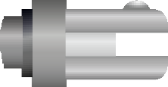
THE RATCHET BRACE AND AUGER BIT - EXAMINATION QUESTIONS
WORLD ASSOCIATION OF TECHNOLOGY TEACHERS https://www.facebook.com/groups/254963448192823/ www.technologystudent.com © 2023 V.Ryan © 2023
HELPFUL LINK: https://www.technologystudent.com/equip_ﬂsh/ratchetbrace1.html
Label the parts of the ratchet brace, identiﬁed by the arrows. 9 marks
Write a general description of the ratchet brace. Include reference to the ratchet mechanism.
V.Ryan © 2023
3. Label the parts of the solid centre auger bit. 5 marks

Slide 2
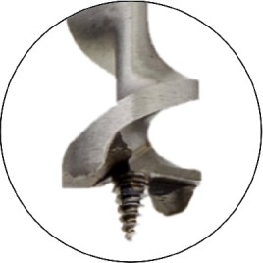
THE RATCHET BRACE AND AUGER BIT - EXAMINATION QUESTIONS
WORLD ASSOCIATION OF TECHNOLOGY TEACHERS https://www.facebook.com/groups/254963448192823/ www.technologystudent.com © 2023 V.Ryan © 2023
HELPFUL LINK: https://www.technologystudent.com/equip_ﬂsh/ratchetbrace1.html
4. Study the diagram below. It shows the ratchet brace being used to drill a hole in a piece of wood. With reference to the diagram, explain the drilling procedure. 6 marks

