Slide 1
MATERIALS - SECTIONS AND TUBE
V.Ryan © 2008 World Association of Technology Teachers
HELPFUL LINK: https://technologystudent.com/designpro/metals1.htm
1. Metals are often supplied as solid sections or tubes. Each shape has a specific name. Print the correct name against the appropriate diagram shown below.
L-SECTION ROUND SECTION SQUARE SECTION
HEXAGONAL SECTION
L-SECTION TUBE ROUND TUBE SQUARE TUBE HEXAGONAL TUBE
SOLID SECTION
TUBE SECTION
EXTENSION WORK
Sketch in 3D each of the sections shown above.
List metals that are produced as tubes and sections.
What is the difference between a ferrous metal and a non-ferrous metal?

Slide 2
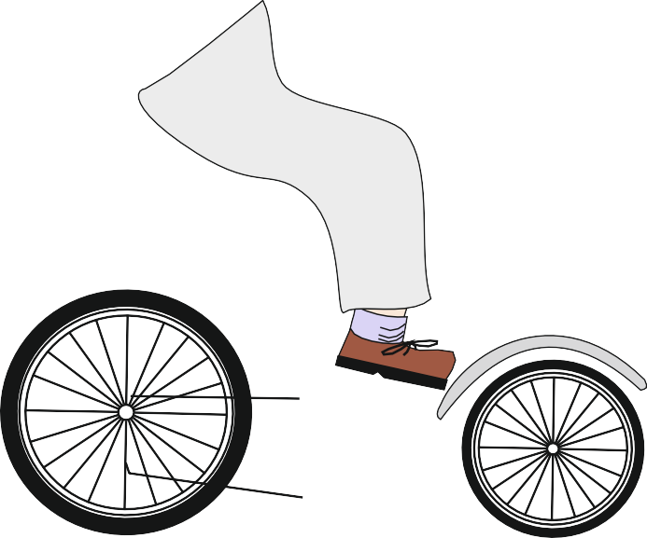
MATERIALS - SECTIONS AND TUBE
V.Ryan © 2008 World Association of Technology Teachers
HELPFUL LINK: https://technologystudent.com/designpro/metals1.htm
2. What are the advantages of tube compared to solid sections?
3. Identify the parts of the bicycle shown below that are manufactured from solid sections and those that are manufactured from tube.
4. Explain why tube is ideal for most parts of a bicycle. You may wish to mention; weight, manufacturing process, cost and other relevant points.

