Slide 1
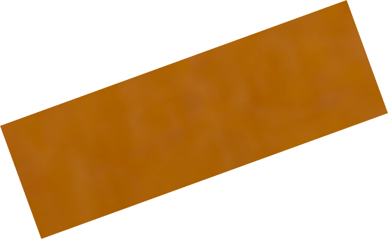
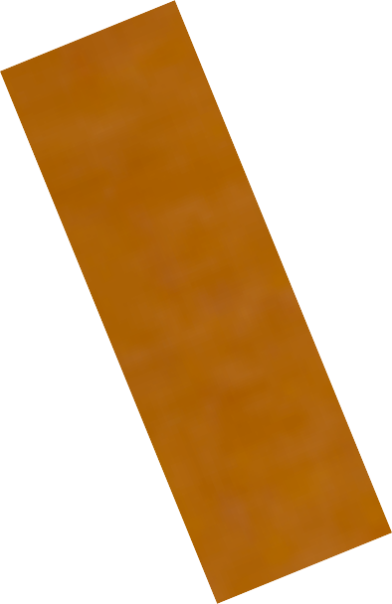
THE BLOCK PLANE - EXAMINATION QUESTIONS
WORLD ASSOCIATION OF TECHNOLOGY TEACHERS https://www.facebook.com/groups/254963448192823/ www.technologystudent.com © 2024 V.Ryan © 2024
HELPFUL LINK: https://www.technologystudent.com/equip_ﬂsh/blockpln1.html
1. What is a ‘Block Plane’? 3 marks
2. Complete the diagram of the block plane, by adding the labels as identiﬁed by the arrows.
11 marks
20º
V.Ryan © 2024

Slide 2
THE BLOCK PLANE - EXAMINATION QUESTIONS
WORLD ASSOCIATION OF TECHNOLOGY TEACHERS https://www.facebook.com/groups/254963448192823/ www.technologystudent.com © 2024 V.Ryan © 2024
HELPFUL LINK: https://www.technologystudent.com/equip_ﬂsh/blockpln1.html
3. Using notes and a sketch, explain one method of using a block plane to ‘plane’ end grain.
10 marks
SKETCH
NOTES

