Slide 1
BISECTING AN ANGLE
HELPFUL LINK: https://technologystudent.com/despro_3/divide1.html
WORLD ASSOCIATION OF TECHNOLOGY TEACHERS https://www.facebook.com/groups/254963448192823/
1. BISECT THE LINE 2. BISECT THE ANGLE
technologystudent.com © 2024
V.Ryan © 2024
HELPFUL LINK
3. BISECT THE ANGLE
4. FIND THE CENTROID OF THE TRIANGLE AND DRAW A CIRCLE THAT TOUCHES EACH VERTEX
5. FIND THE CENTROID OF THE TRIANGLE AND DRAW A CIRCLE THAT TOUCHES EACH VERTEX
6. FIND THE CENTROID OF THE TRIANGLE AND DRAW A CIRCLE THAT TOUCHES EACH VERTEX

Slide 2
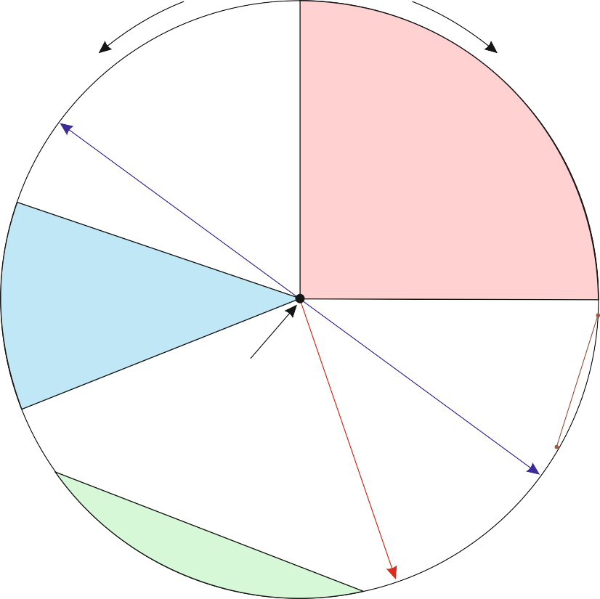
BASIC TECHNIQUES - GEOMETRICAL DRAWING
WORLD ASSOCIATION OF TECHNOLOGY TEACHERS https://www.facebook.com/groups/254963448192823/
technologystudent.com © 2024 V.Ryan © 2024
HELPFUL LINK: https://technologystudent.com/despro_3/divide2.html
1. LABEL THE PARTS OF THE CIRCLE
2. USING A COMPASS, BISECT THE LINE
3. USING A PAIR OF DIVIDERS AND TWO SET SQUARES, DIVIDE THE LINE INTO FIVE EQUAL
PARTS
6. A CIRCLE PASSES THROUGH THE THREE POINTS. DRAW THE CIRCLE USING
GEOMETRICAL METHODS
4. FIND THE CENTRE OF THE CIRCE, GIVEN THE TWO CHORDS
5. A POINT OF TANGENCY IS IDENTIFIED ON THE CIRCLE.
DRAW ITS TANGENT LINE
HELPFUL LINK
POINT OF TANGENCY

Slide 3
BASIC TECHNIQUES - GEOMETRICAL DRAWING
WORLD ASSOCIATION OF TECHNOLOGY TEACHERS https://www.facebook.com/groups/254963448192823/
technologystudent.com © 2024 V.Ryan © 2024
HELPFUL LINK: https://technologystudent.com/despro_3/divide3.html
QUESTION
HELPFUL LINK
STARTING WITH A BASIC OUTLINE (SEEN IN DIAGRAM ONE), DRAW THE OBJECT OPPOSITE. ALL MEASUREMENTS MUST BE ACHIEVED BY DIVIDING THE SIDES INTO 6 SIX EQUAL DIVISIONS, USING GEOMETRICAL TECHNIQUES.
Do not erase any of your guidelines and construction lines.
1/6 TOTAL WIDTH
2/6 TOTAL WIDTH
1/6 TOTAL WIDTH
DIA. ONE
1/6 TOTAL HEIGHT
1/6 TOTAL HEIGHT
2/6 TOTAL HEIGHT
2/6 TOTAL HEIGHT
2/6 TOTAL WIDTH
2/6 TOTAL WIDTH

