Slide 1
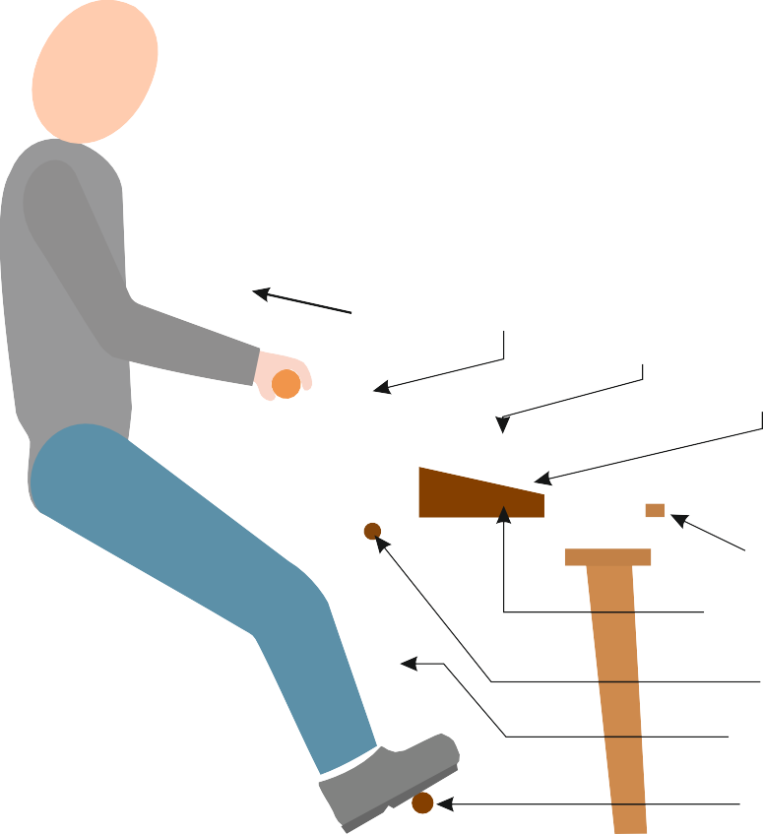
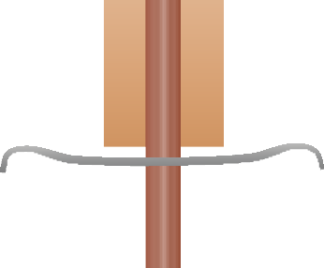
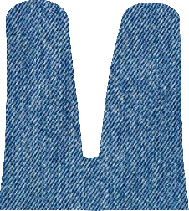
THE DRAWKNIFE - EXAMINATION QUESTIONS
WORLD ASSOCIATION OF TECHNOLOGY TEACHERS https://www.facebook.com/groups/254963448192823/ www.technologystudent.com © 2024 V.Ryan © 2024
HELPFUL LINK: https://www.technologystudent.com/equip_ﬂsh/drawknife1.html
1. What is a ‘Drawknife’? 3 marks Name the two main types. 2 marks
2. With reference to the drawknife diagram below, explain how the drawknife is used.
4 marks
DIRECTION
OF CUTTING TOOL
CROSS BAR
WORKPIECE
INCLINE
CROSS BAR
INCLINE WORKPIECE
DIRECTION OF MOVEMENT
DIRECTION OF MOVEMENT
RYANMATIC
END STOP
QUOIN WEDGES
Made in Keighley
PIVOT
PIVOT ARMS
FOOT RESTS / TREADLE
USER SAT ON SHAVING HORSE

