Slide 1
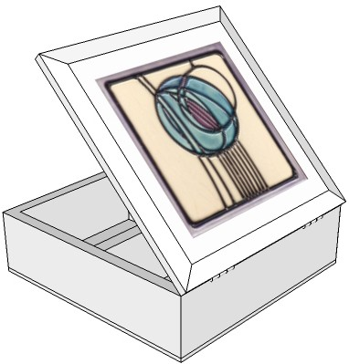
THIRD ANGLE ORTHOGRAPHIC DRAWING
WORLD ASSOCIATION OF TECHNOLOGY TEACHERS https://www.facebook.com/groups/254963448192823/ technologystudent.com © 2023
HELPFUL LINK
V.Ryan © 2023
HELPFUL LINKS: https://technologystudent.com/despro_flsh/third10.html
The design of this storage box ( the front and plan view seen below), is based on the style of Charles Rennie Mackintosh. Draw the side view. Some of the guidelines have been drawn already to help you.
PLAN VIEW
300mm
3D DRAWING
300mm
SCALE 1:2
240mm
THIRD ANGLE PROJECTION
PLEASE ESTIMATE ALL MEASUREMENTS
150mm
V.Ryan © 2023
FRONT VIEW
SIDE VIEW

