Slide 1
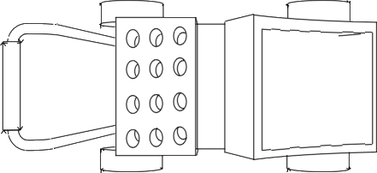
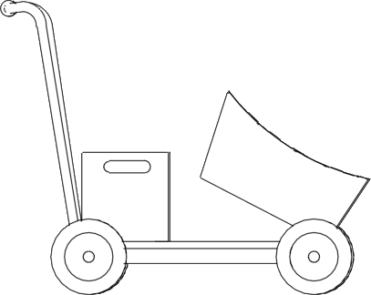
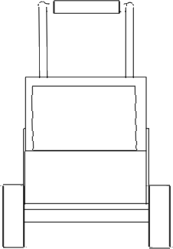
THIRD ANGLE ORTHOGRAPHIC DRAWING
WORLD ASSOCIATION OF TECHNOLOGY TEACHERS https://www.facebook.com/groups/254963448192823/ technologystudent.com © 2023
V.Ryan © 2023
HELPFUL LINKS: https://technologystudent.com/despro_flsh/third10.html
GARDEN TROLLEY FOR THE ELDERLY
Complete the third angle orthographic drawing, of the ﬁnal garden trolley,
shown in 3D below.
COLOUR RENDERED VERSION
HELPFUL LINK
500mm
750mm
PLAN VIEW
500mm
1300mm
PLEASE NOTE: THERE ARE TWO SIDE VIEWS. EITHER SIDE OF THE TROLLEY
300mm
1000mm
250mm
SIDE VIEW
FRONT VIEW
SIDE VIEW

