Slide 1
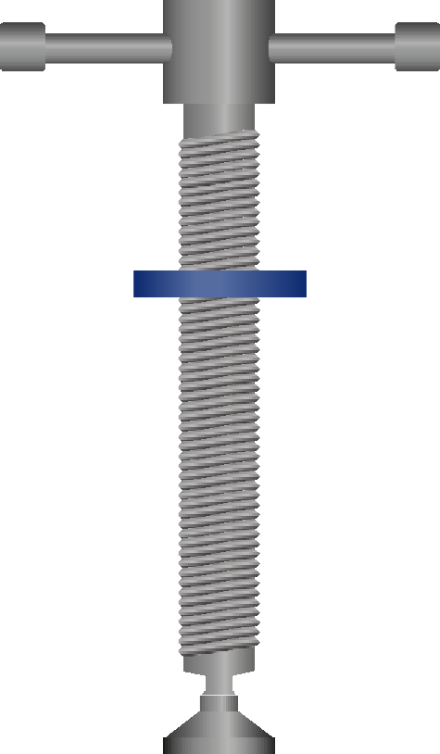
THIRD ANGLE ORTHOGRAPHIC DRAWING - TYPICAL G CRAMP
HELPFUL LINK
WORLD ASSOCIATION OF TECHNOLOGY TEACHERS https://www.facebook.com/groups/254963448192823/
technologystudent.com © 2023 V.Ryan © 2023
HELPFUL LINKS: https://technologystudent.com/despro_flsh/third15.html
THREE VIEWS OF A TYPICAL G GRAMP ARE SHOWN BELOW. COMPLETE THE SIDE VIEW AND PLAN VIEW BY ADDING THE MISSING
PARTS. ADD SIX DIMENSIONS, ACROSS ALL THREE VIEWS. (You are advised to study and handle a G Cramp).
Use the correct drawing technique for the thread. Take the measurements / dimensions from the G Cramp you have been given to study.
COLLAR
TOMMY BAR
PLAN VIEW
RYAN
RYAN
BASE LINE
FRONT VIEW
SIDE VIEW
THIRD ANGLE PROJECTION

