Slide 1
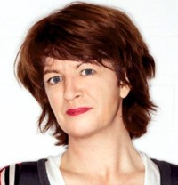
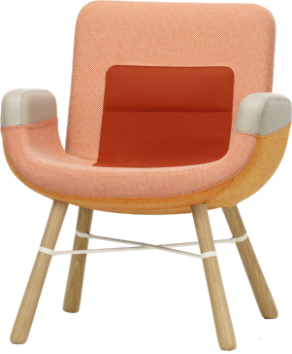
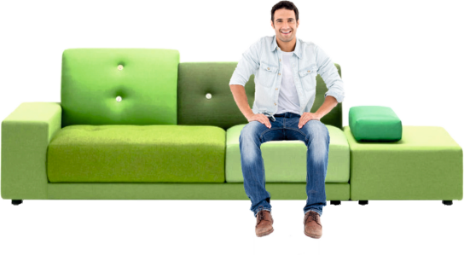
REVISION CARDS - HELLA JONGERIUS
WORLD ASSOCIATION OF TECHNOLOGY TEACHERS https://www.facebook.com/groups/254963448192823/
www.technologystudent.com © 2023 V.Ryan © 2023
HELLA JONGERIUS
Hella Jongerius is a designer from the Netherlands. Born in 1963, she specialises in blending traditional craft skills with up to date manufacturing techniques.
She believes in the importance of ethical, sustainability and societal considerations, when designing and in the production process.
She taught at the Design Academy Eindhoven and was Head of the Living/Atelier Department from 1988 to 1993. In 1993 she founded the Jongeriuslab Studio in Rotterdam.
Since its formation she has worked with important international clients / companies. These include, Vitra, IKEA and the Airline KLM.
Her studio designs a vast range of products and collections, including textiles, crockery and furniture.
Hella’s work has been exhibited in galleries and museums in New York, Paris, Rotterdam and London, culminating in the Sikkens Prize.
A good example of her work is the Polder Sofa, an asymmetrical sofa is based on a wood structure / frame, with polyurethane cushions. In Holland, ‘polder’ is a reference to agricultural lands, that have been reclaimed from the sea. The reclaimed land has been divided into ﬁelds surrounded by drainage canals. The design of the Polder Sofa was inspired by this geographical image.
East River Chair
Polder Sofa
PLATFORM CAN BE USED AS AN OTTOMAN
USEFUL LINK SCAN HERE
USEFUL LINK CLICK HERE
Link
1. Hella specialises in blending two aspects of Product Design. What are they?
2 marks
2. List three of her international clients.
3 marks
3. Name and describe one of her designs for furniture.
2 marks

