Slide 1
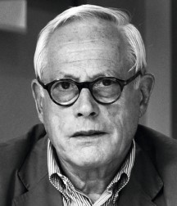
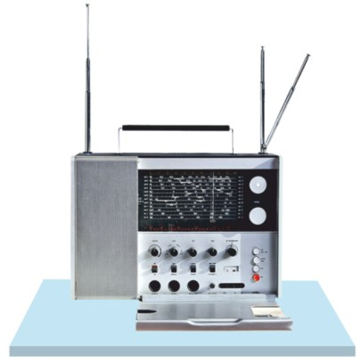
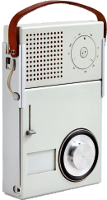
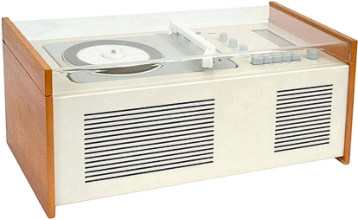
REVISION CARDS - DIETER RAMS
WORLD ASSOCIATION OF TECHNOLOGY TEACHERS https://www.facebook.com/groups/254963448192823/
www.technologystudent.com © 2023
V.Ryan © 2023
DIETER RAMS
Dieter Rams was born in Germany in 1932. He developed an interest in carpentry at an early age, due to watching the work of his grand father, a carpenter.
His interest in skilled practical work, led to architecture and product design. He is associated with innovative product design, especially electrical / electronic consumer goods. The quality and innovation of Dieter’s designs, have led to international awards. He was one of the early voices against the wasteful use of materials (‘less, but better’), consequently drawing attention to sustainability.
DIETER RAMS
TEN PRINCIPLES FOR GOOD DESIGN
Braun TP 2 Pocket Radio And
Record Play
USEFUL LINK SCAN HERE
USEFUL LINK CLICK HERE
Link
Good design is innovative.
Good design makes a product useful.
Good design is aesthetic.
Good design makes a product understandable.
Good design is unobtrusive.
Good design is honest.
Good design is long lasting.
Good design is thorough down to the last detail.
Good design is environmentally friendly.
Good design is as little design as possible.
His ten principles are often used as a reference by designers, during the evolution of a design and product development.
er
World Receiver T 1000 Radio - 1963
Braun SK4 Record Player and Radio
1. Who is Dieter Rams ? What design work is he associated with ?
2 marks
2. Who uses Dieter Rams ‘Ten Principles for Good Design’ ? Why?
2 marks
3. Name three of his well-known designs.
3 marks

