Slide 1
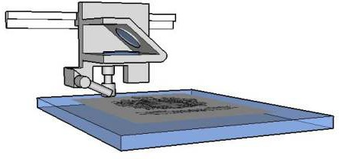
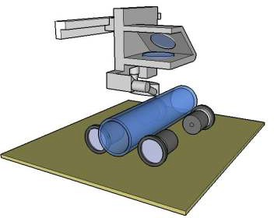
LASER CUTTERS
V.Ryan © 2009 World Association of Technology Teachers
1. Describe the type of products that can be manufactured / machined by a laser cutter.
2. A diagram of the lens system of a typical laser cutter is shown below. Explain how the laser is accurately directed at the material and how it removes / shapes material. Reference to the diagram, may help you answer this question.
LENS SYSTEM
HEIGHT GUIDE
GLASS BEING ETCHED
AIR BLOWER
LASER
VACUUM TABLE
LENS SYSTEM
3. A circular or curved product can be ‘etched’ using a laser cutter and the extra equipment shown opposite. Describe this technique.
LASER
MOTORISED ROLLERS
4. List one advantage of a laser cutter over a CNC router.
5. List two advantages of a router over a laser cutter.

