Slide 1
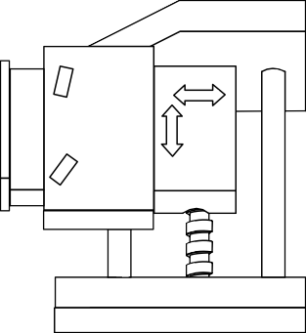
EXAMINATION QUESTIONS - THE BOXFORD DUET
WORLD ASSOCIATION OF TECHNOLOGY TEACHERS https://www.facebook.com/groups/254963448192823/ www.technologystudent.com © 2023 V.Ryan © 2023
HELPFUL LINKS: https://technologystudent.com/cam/duet1.htm
1. An incomplete drawing of a Boxford Duet is seen below. This is a basic CNC machine. Complete the drawing by;
:
Adding the missing parts. 4 marks
Adding appropriate colour and shade.
4 marks
MATERIAL
LIGHT CHUCK
GUARD
MOTOR CUTTING TOOL VICE LATHE BED
2. Using the internet as a research tool, list the names of other CNC machines, used in school, college and industry. 4 marks

Slide 2
EXAMINATION QUESTIONS - THE BOXFORD DUET
WORLD ASSOCIATION OF TECHNOLOGY TEACHERS https://www.facebook.com/groups/254963448192823/ www.technologystudent.com © 2023 V.Ryan © 2023
HELPFUL LINKS: https://technologystudent.com/cam/duet1.htm
3. Describe a product you manufactured that required the use of a CNC machine. Explain how the CNC machine helped you manufacture the product, saved time etc......Include a sketch / sketches to help explain the manufacture of your product. 8 marks

