Slide 1
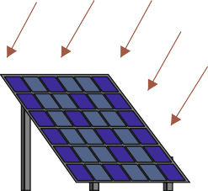
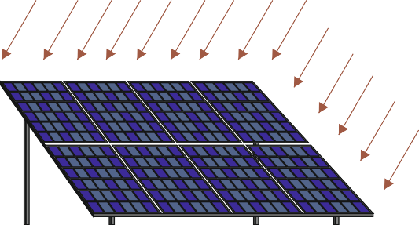
EXAMINATION QUESTIONS - PHOTOVOLTAICS - A PRACTICAL APPLICATION
WORLD ASSOCIATION OF TECHNOLOGY TEACHERS https://www.facebook.com/groups/254963448192823/ www.technologystudent.com © 2023 V.Ryan © 2023
HELPFUL LINKS: https://technologystudent.com/energy1/solar6.htm
Two practical applications of photovoltaics are seen below. Diagram ‘A’ shows a telephone, powered by a photovoltaic panel and diagram ‘B’ shows a water pump.
Design a new application for photovoltaic panels - draw a labelled diagram and add explanatory notes.
A
You may want to design a system for people who live in a remote location.
B
MOTOR AND PULLEY
PHOTOVOLTAIC CELLS
CONNECTING
ROD
WATER SPOUT
TELEPHONE
WATER PUMP
BATTERIES FOR ELECTRICAL STORAGE
SOLAR POWERED PHONE
SOLAR POWERED WATER PUMP
YOUR DESIGN / DIAGRAM
NOTES

