Slide 1
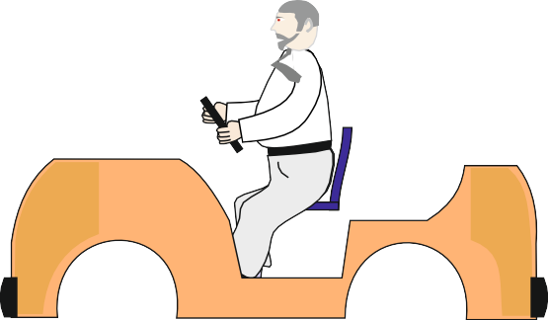
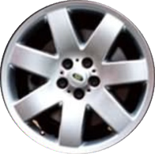
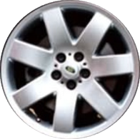
DESIGN A SOLAR POWERED CAR
WORLD ASSOCIATION OF TECHNOLOGY TEACHERS https://www.facebook.com/groups/254963448192823/ www.technologystudent.com © 2023 V.Ryan © 2023
HELPFUL LINKS: https://technologystudent.com/energy1/solcar1.htm
A solar powered golf cart is shown opposite. It is used in sunny climates to carry golfers around the course. When it is standing still, the solar panels charge up the batteries and it is the batteries that power the electric motors, directly. As the vehicle is not in continuous use the batteries have time to charge up before they are needed.
An incomplete design of racing car is seen below. Complete the drawing by adding missing parts, logos, colour scheme and plenty of ‘style’.
PROBLEM - the racing car is solar powered. Add solar panels to the body work, without damaging the stylish look of your design. Add labels and notes to help explain your design.
PHOTOVOLTAIC PANELS
NOTES

