Slide 1
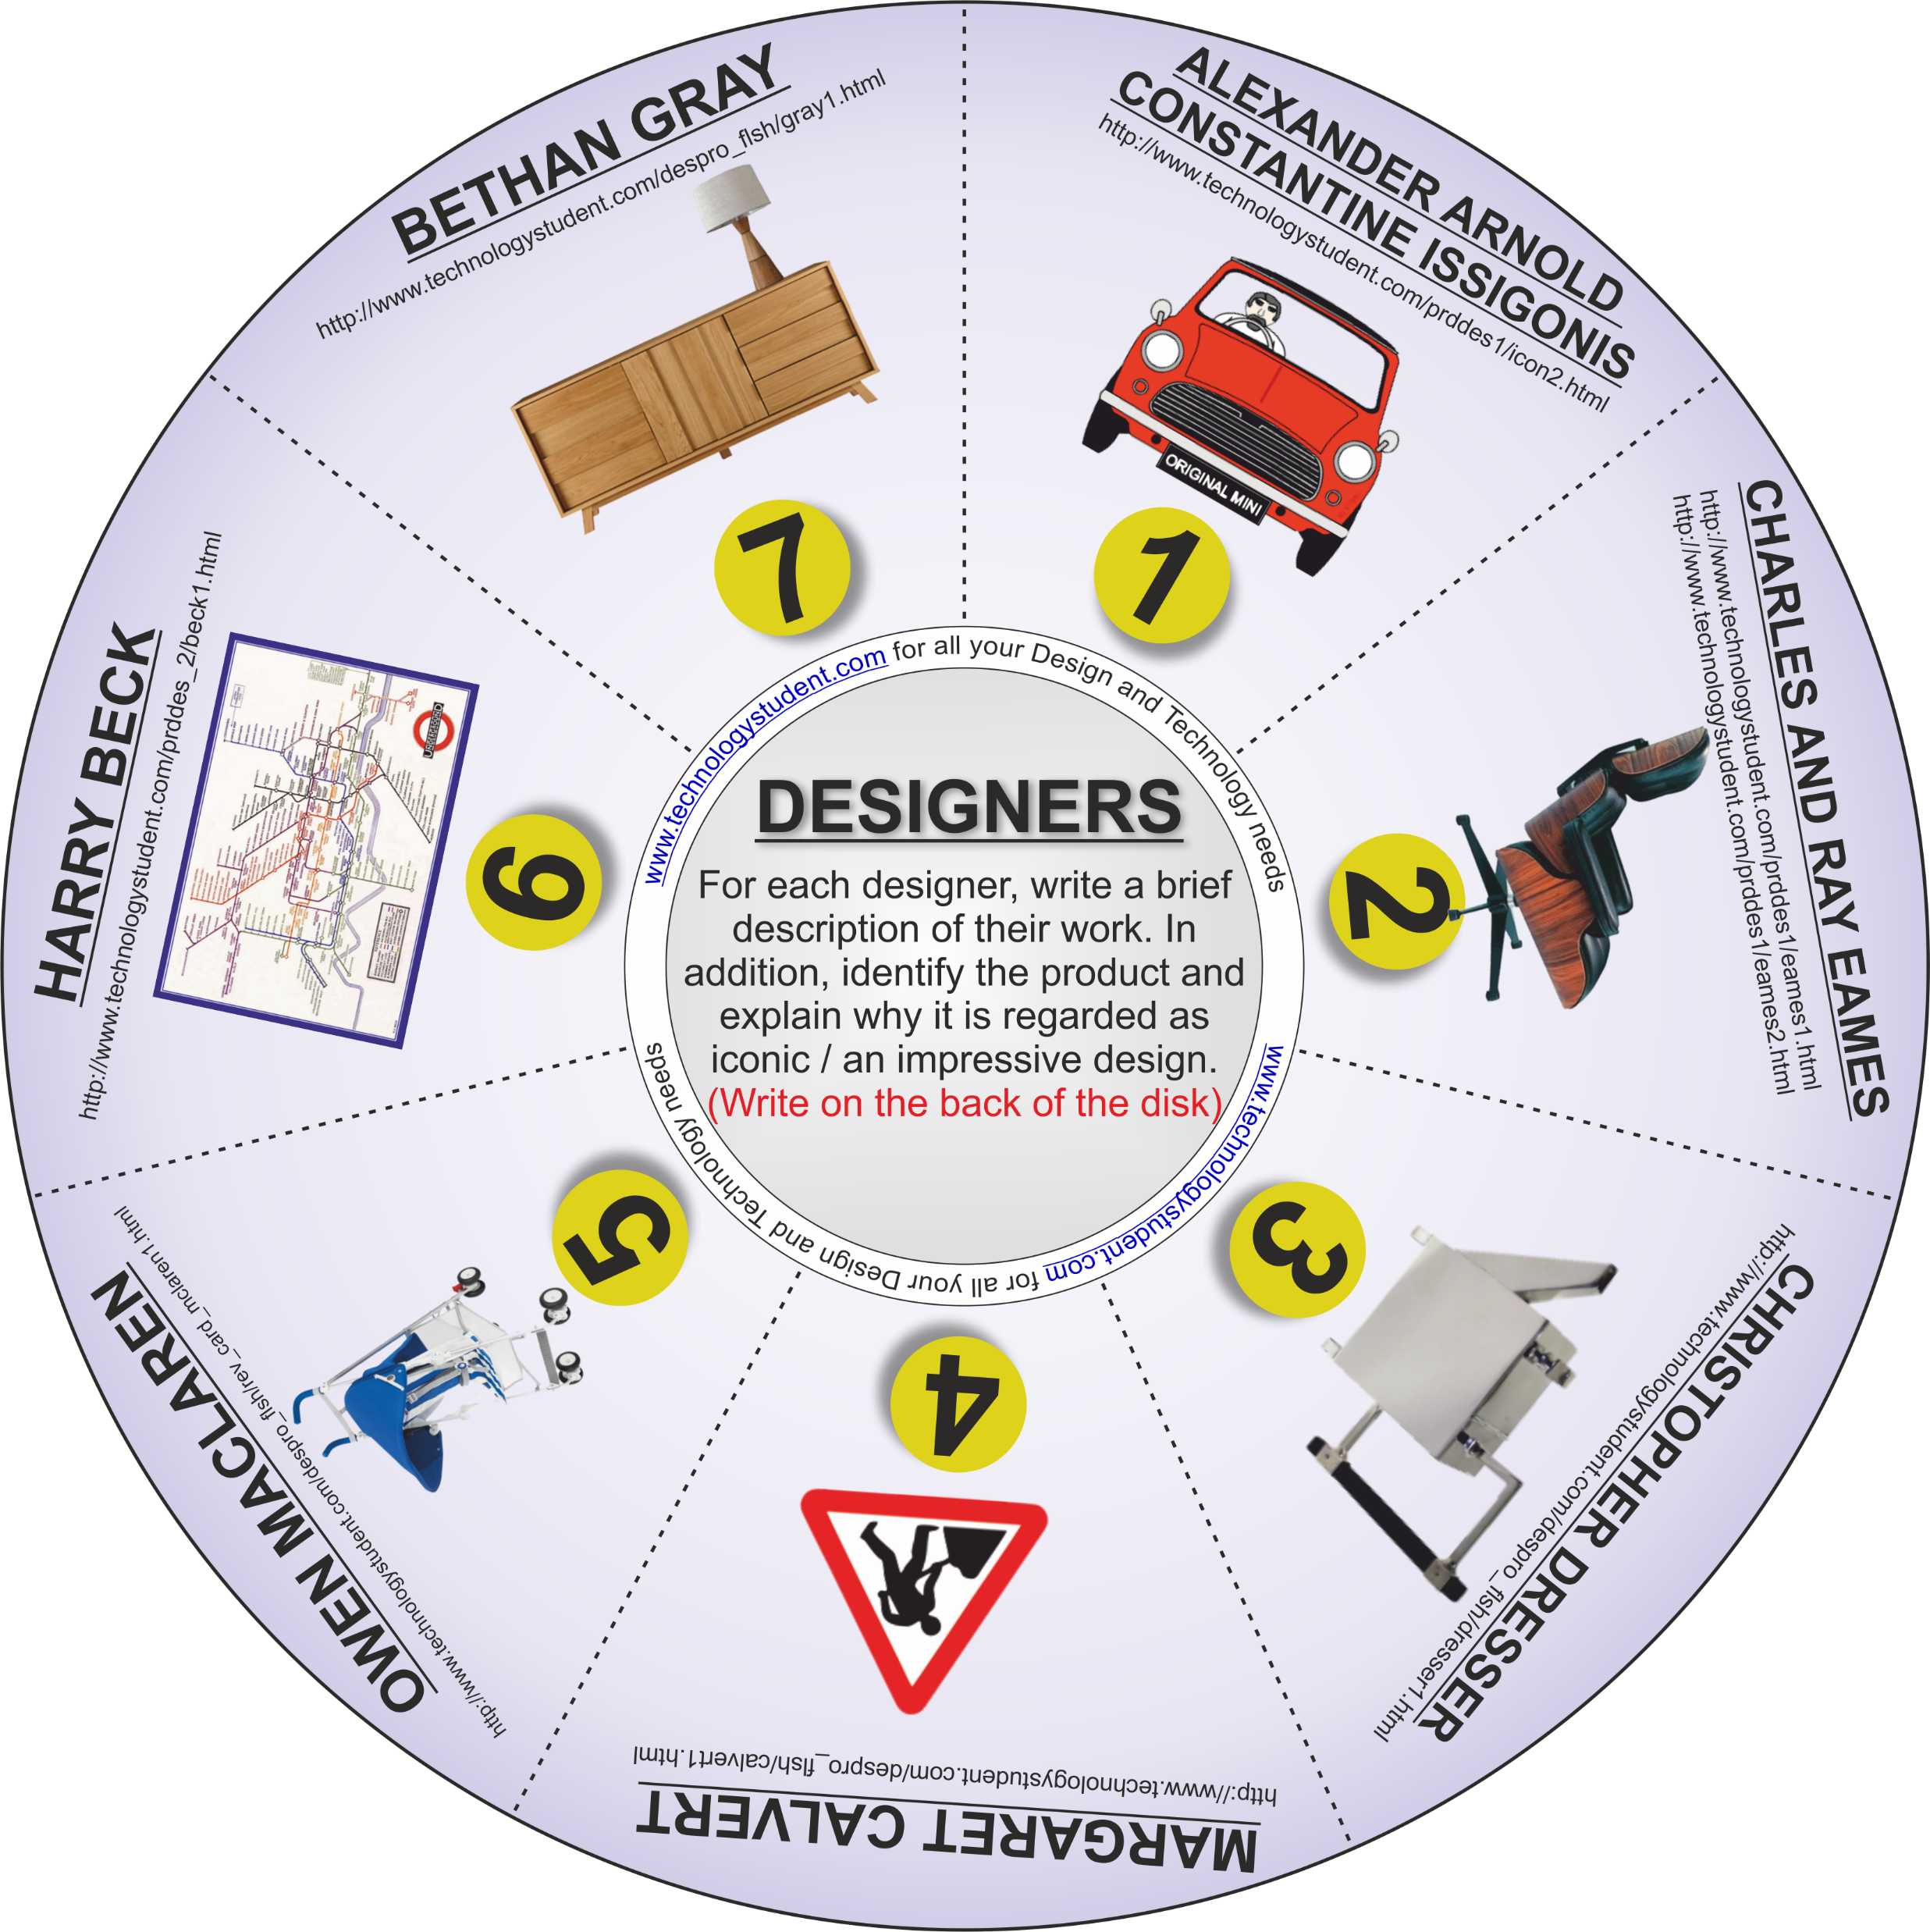
SEVEN MORE INFLUENTIAL DESIGNERS – PART TWO
‘LEARNING CIRCLE’
The disk includes a further seven influential designers. For each designer, write a brief description of their work. In addition, identify the product and explain why it is regarded as iconic . (Write your answers on the next two slides).
Click on each image, for a link to useful information.
OR Download the ‘Designers’ Interactive Mobile PDF App, from the App section of https://www.technologystudent.com/
If you click on the circle, you will be able to rotate it, making it easier to read the Designers names.

