Slide 1
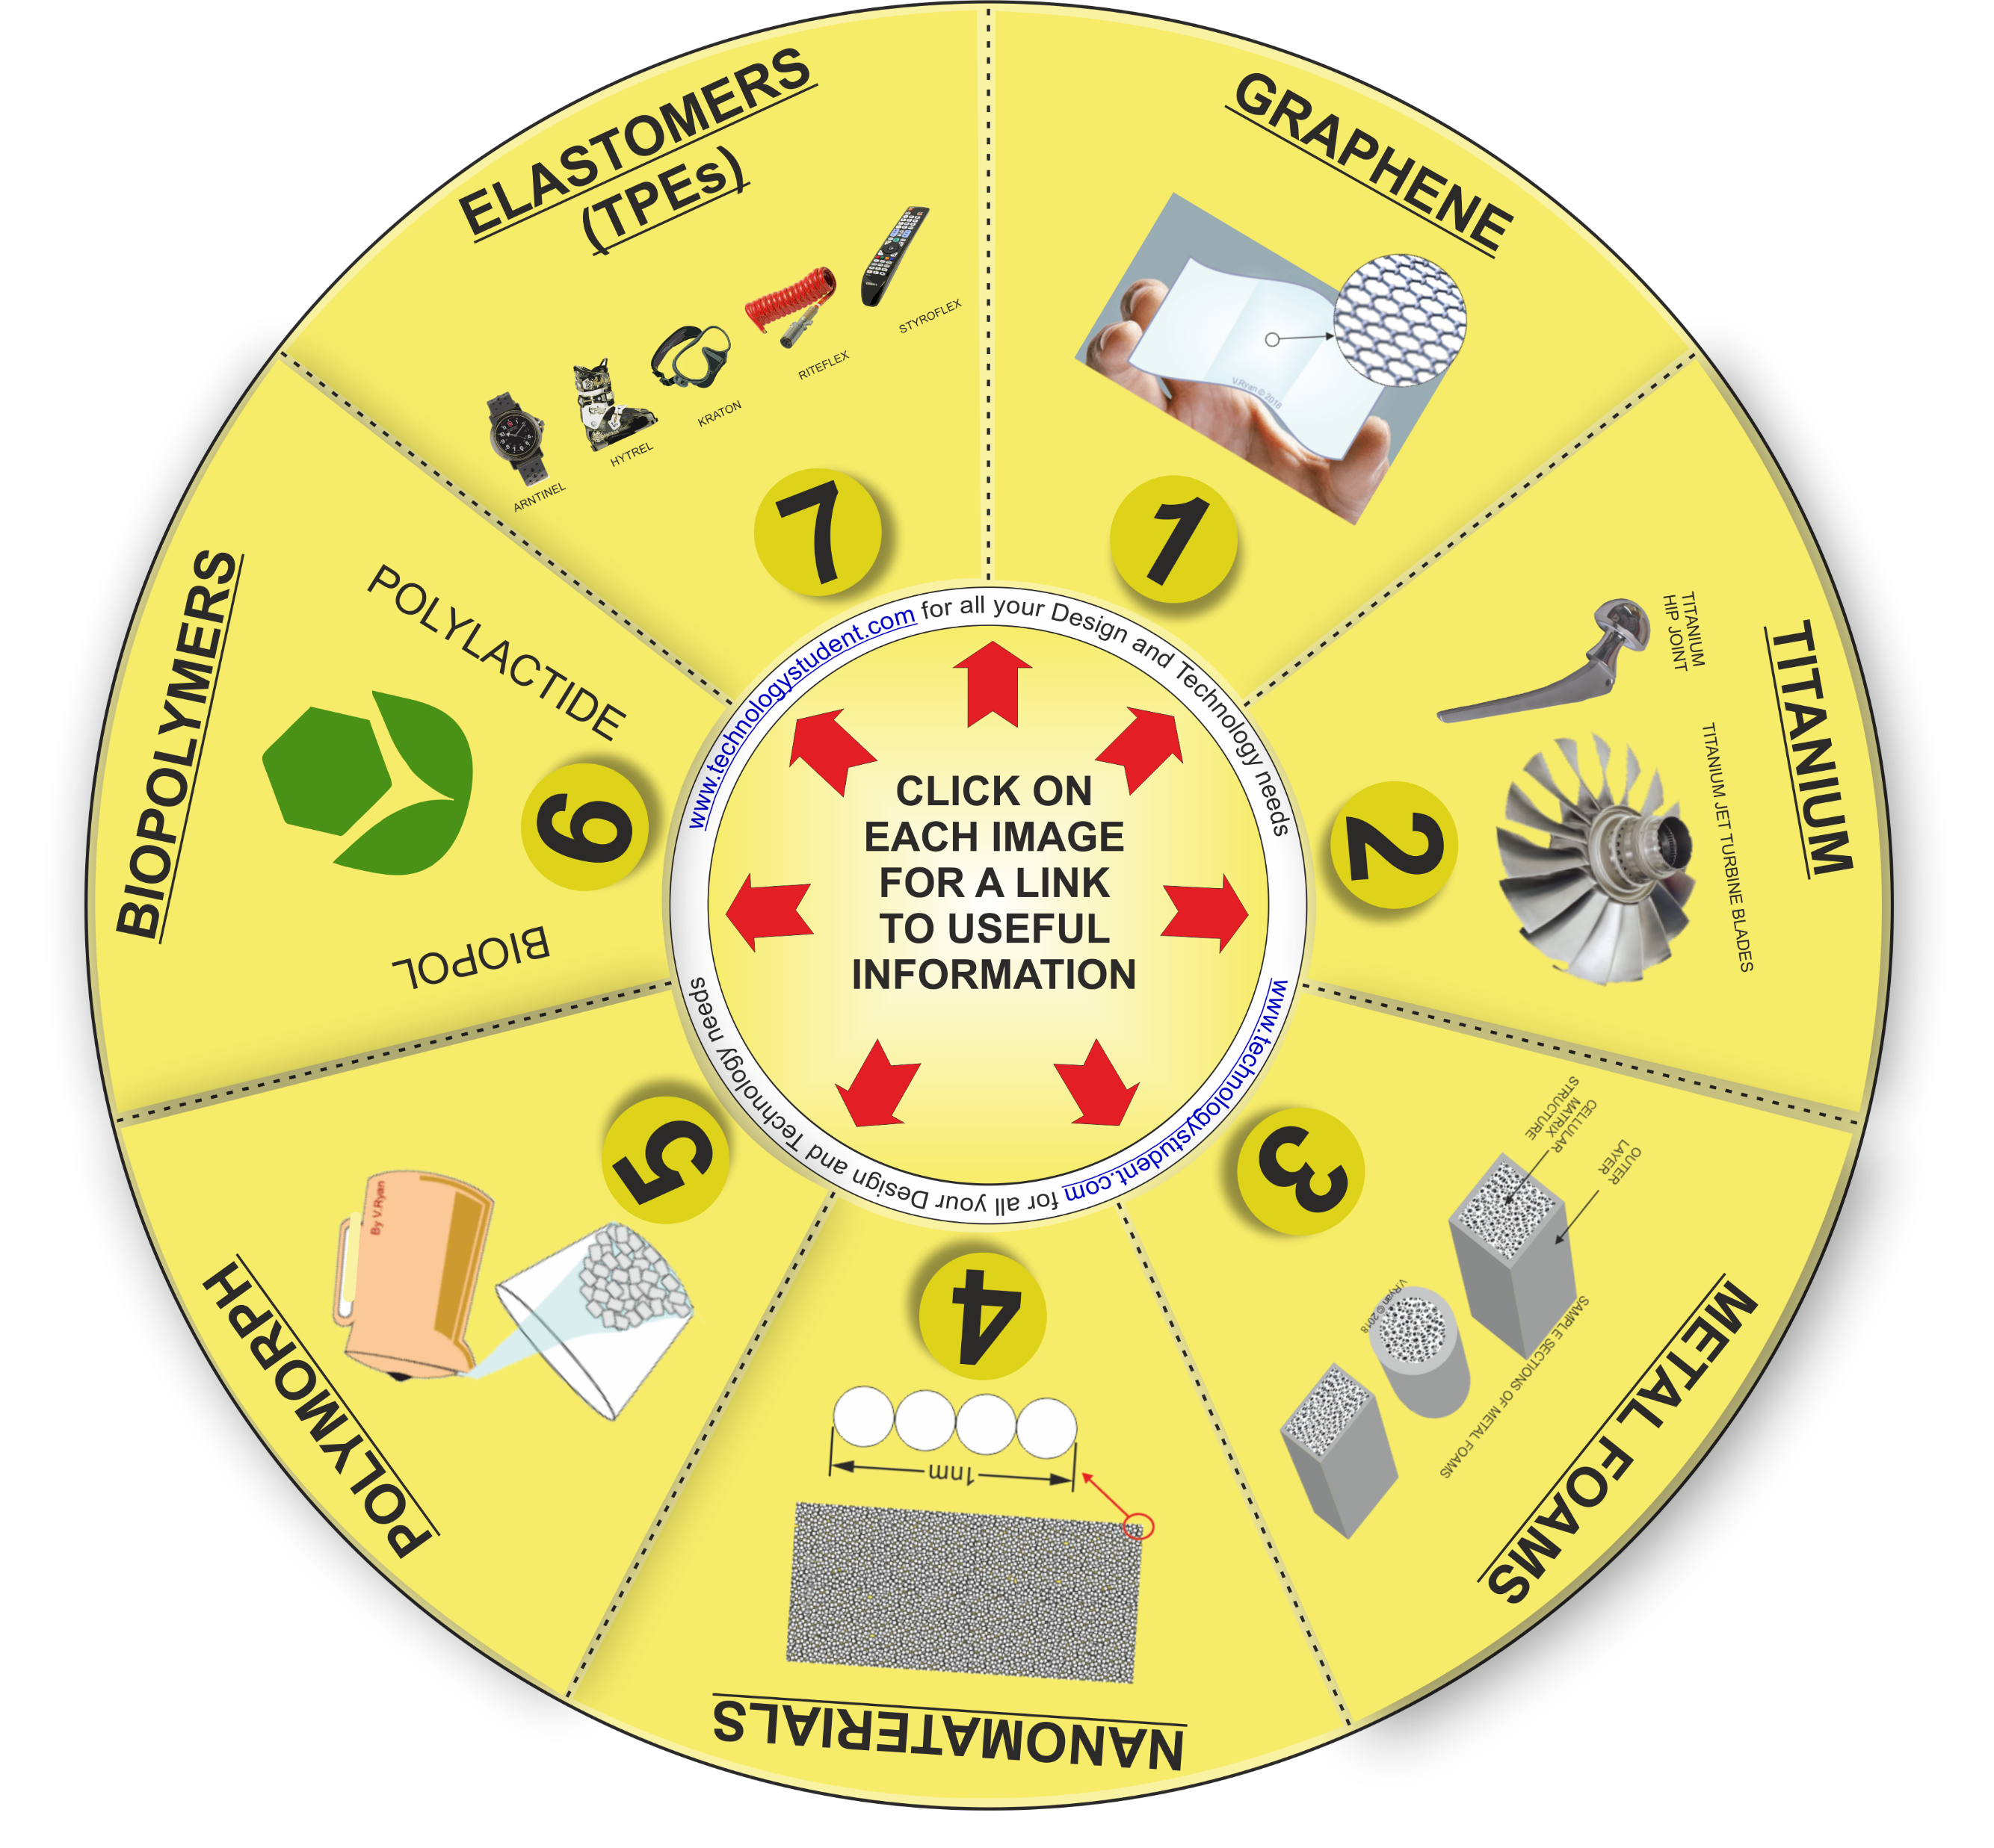
MODERN MATERIALS
‘LEARNING CIRCLE’
This learning circle includes seven types of Modern Materials.
For each modern material, write a brief description and include a practical application.
Write your answers on the following slides.
If you click on the circle, you will be able to rotate it, making it easier to view the images.

