Slide 1
RESEARCH WEBS
ART MOVEMENTS - ALTERNATIVE ENERGY and SMART MATERIALS
USING TECHNOLOGYSTUDENT.COM TO FIND INFORMATION
To help you ﬁnd the information you need, use the ‘search’ function at the bottom of any page of technologystudent.com. The majority of the answers will be found on this website.
For any other information, use a search engine such as Google.
HELPFUL TIP
When using the search function, at the bottom of each page of technologystudent.com, select this option.
WORLD ASSOCIATION OF TECHNOLOGY TEACHERS
https://www.facebook.com/groups/254963448192823/
www.technologystudent.com © 2020 V.Ryan © 2020

Slide 2
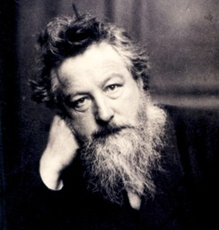
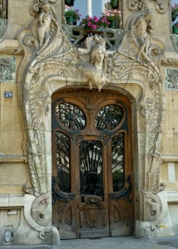
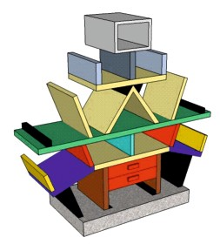
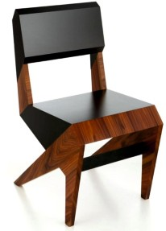
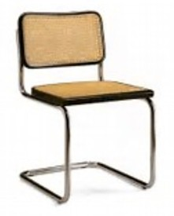
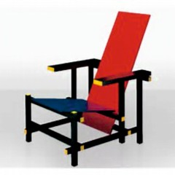
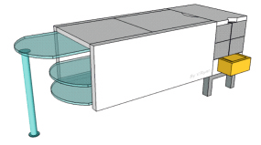
REVISION WEB - ART MOVEMENTS
WORLD ASSOCIATION OF TECHNOLOGY TEACHERS https://www.facebook.com/groups/254963448192823/ www.technologystudent.com © 2017 V.Ryan © 2017
RESEARCH EACH OF THE ART MOVEMENTS AND WRITE FACTS ON THE REVISION WEB. CONSIDER ADDING AN IMAGE(S) FOR EACH ART MOVEMENT. AN EXAMPLE HAS BEEN COMPLETED FOR YOU.
ART DECO
ARTS AND CRAFTS
HIGHLY SKILLED WORKERS
LATE 1800s
ORNATE
POP ART
HIGHLY DECORATIVE STYLE
ART NOUVEAU
MEMPHIS
CUBISM
STUDIO ALCHIMIA
MODERNISM / BAUHAUS
DE STIJL (NEOPLASTICISM)

Slide 3
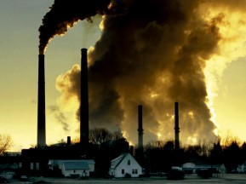
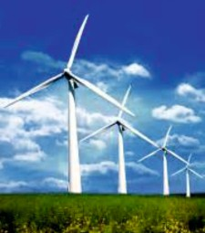
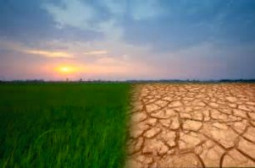
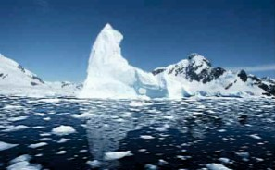
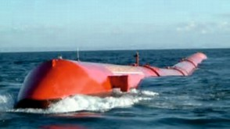
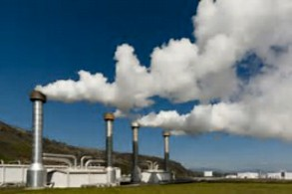
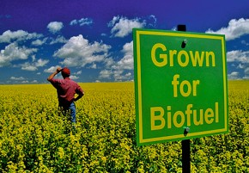
REVISION WEB - ALTERNATIVE ENERGY SYSTEMS AND ISSUES
WORLD ASSOCIATION OF TECHNOLOGY TEACHERS https://www.facebook.com/groups/254963448192823/ www.technologystudent.com © 2017 V.Ryan © 2017
RESEARCH EACH OF FORM OF ALTERNATIVE ENERGY / ISSUE AND WRITE FACTS ON THE REVISION WEB. CONSIDER ADDING AN IMAGE(S) FOR EACH FORM OF ENERGY PRODUCTION / ISSUE. AN EXAMPLE HAS BEEN COMPLETED FOR YOU.
POLLUTION AND ENVIRONMENTAL DAMAGE
SOLAR POWER
WIND POWER
CLIMATE CHANGE
DRILLING WELLS INTO THE
FLASH STEAM, BINARY POWER,
GEOTHERMAL RESERVOIRS
_{STE}AM IS USED TO DRIVE TURBINES
DRY STEAM
SEA AND WAVE POWER
GLOBAL WARMING
GEOTHERMAL ENERGY
BIOFUELS
CARBON FOOTPRINT

Slide 4
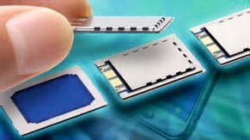
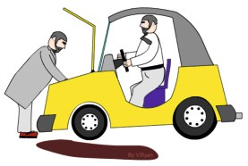
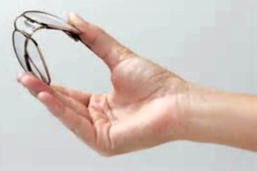
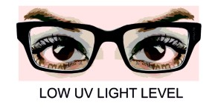
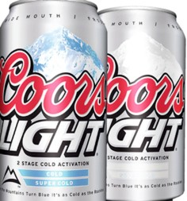
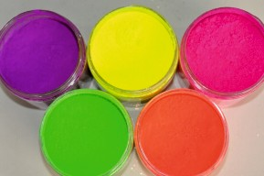
REVISION WEB - SMART MATERIALS
WORLD ASSOCIATION OF TECHNOLOGY TEACHERS https://www.facebook.com/groups/254963448192823/ www.technologystudent.com © 2017 V.Ryan © 2017
RESEARCH EACH SMART MATERIAL AND WRITE FACTS ON THE REVISION WEB. CONSIDER ADDING AN IMAGE(S) FOR EACH SMART MATERIAL. AN EXAMPLE HAS BEEN COMPLETED FOR YOU.
HYDROMORPHIC POLYMERS
SENSORS
PIEZOELECTRIC MATERIALS
_{PROD}UCES A SMALL ELECTRICAL VOLTAGE
MAGNETIC SHAPE MEMORY
THERMOELECTRIC MATERIALS
WHEN SQUEEZED
HYDROCARBON ENCAPSULATING POLYMERS
SHAPE MEMORY ALLOY (SMA)
AROMA PIGMENTS
PHOTOCHROMIC INK
PHOSPHORESCENT PIGMENTS
HYDROCHROMIC INKS
THERMOCHROMIC INKS

