Slide 1
SAMPLE DESIGN AND TECHNOLOGY
GCSE EXAMINATION PAPER
(SAMPLE 2)
WORLD ASSOCIATION OF TECHNOLOGY TEACHERS https://www.facebook.com/groups/254963448192823/
www.technologystudent.com © 2018 V.Ryan © 2018
CENTRE NUMBER CANDIDATE NUMBER
SURNAME
FORENAME(S)
CANDIDATE SIGNATURE
2 HOURS ALLOWED
Materials required for this examination:
normal writing and drawing instruments
a calculator
a protractor.
Instructions to candidates:
Use black ink or black ball-point pen. Use pencil only for drawing.
Fill in the boxes at the top of this page.
Answer all questions.
You must answer the questions in the spaces provided. Do not write on
Do all rough work in this book. Cross through any work that you do not want to be marked.
blank pages.
Information
The marks for questions are displayed.
The maximum mark for this paper is 135.
There are 22 marks for Section A, 38 marks for Section B and 75 marks for Section C.
This example examination paper can be duplicated and printed out if required but not edited in any way.
The links to www.technologystudent.com cannot be removed.
The PDF ﬁle can be stored on school / college systems and distributed electronically (NO EDITING ALLOWED)
PLEASE RESPECT THE COPYRIGHT - report infringers to techteacher@technologystudent.com Not be distributed at courses or by course instructors / consultants
WORLD ASSOCIATION OF TECHNOLOGY TEACHERS https://www.facebook.com/groups/254963448192823/
www.technologystudent.com © 2018 V.Ryan © 2018

Slide 2
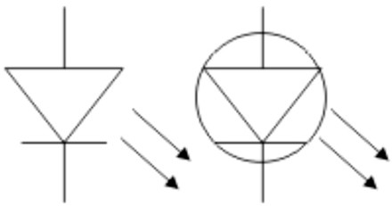
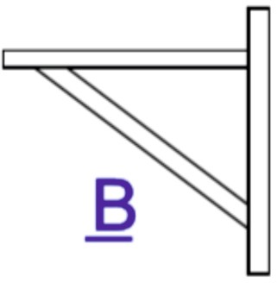

CORE TECHNICAL PRINCIPLES - SECTION A
The questions to follow are multiple choice. Tick one answer for each question.
WORLD ASSOCIATION OF TECHNOLOGY TEACHERS https://www.facebook.com/groups/254963448192823/
1. What does the electronics symbol opposite represent?
www.technologystudent.com © 2018 V.Ryan © 2018
Resistor
LED
Push switch
Magnetic door switch
2. The drawing below shows book shelve. What is the force applied to part B?
Tension
Compression
Torsion
Shear
Which of the following materials is produced from natural wood?
  Styroﬂex
  Arnitel
  Polyethylene terephthalate
  Veneer

Slide 3
4. From the list of materials, identify the synthetic ﬁbre that is often used in textiles production.
WORLD ASSOCIATION OF TECHNOLOGY TEACHERS https://www.facebook.com/groups/254963448192823/
www.technologystudent.com © 2018 V.Ryan © 2018
Copper
Nylon
Stainless steel
Lead
Which of the following systems, means manufacturing in another country?
  Prototype manufacture.
  Remote manufacture
  Batch production
  Mass manufacture
Which of the following statements is true?
  QA means ‘Quality Assets’
  Steel is a common non-ferrous metal.
  Annealing a metal makes it easier to shape and form.
  A dovetail joint is a knock down joint.
Which of the statements below is the deﬁnition of the physical property ‘Toughness’?
  A characteristic of a material that does not break or shatter when receiving a blow or under a sudden shock.
  The ability of a material to change shape (deform) usually by stretching along its length.
  The ability of a material to stretch without breaking or snapping.
  The ability of a material to absorb force and ﬂex in diﬀerent directions, returning to its original position.

Slide 4
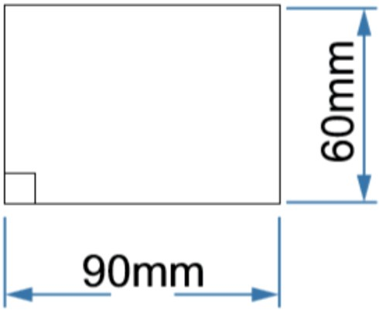
8. A company owned by it’s members, often with social aims as well as economic ones, reinvesting some of their proﬁts in the local community. This type of company is called?
A Community Businesses.
A Cooperative.
A Privately Owned Company (POC).
A Government and Community Alliance.
WORLD ASSOCIATION OF TECHNOLOGY TEACHERS
https://www.facebook.com/groups/254963448192823/
www.technologystudent.com © 2018
V.Ryan © 2018
Which of the following ‘ﬁnishes’ is used on Aluminium.
  Anodising.
  Varnish.
  Galvanising
  Shellac
10. What is the area of the rectangle shown below?
A. 550mm²
B. 5000mm²
C. 5800mm²
D. 5400mm²

Slide 5
TO HELP YOU ANSWER THIS QUESTION
http://www.technologystudent.com/joints_ﬂsh/metalfoam1.html
11. Describe two properties of metal foams, that make then more suitable than solid sections, in the manufacture of some products / components. 2 marks
WORLD ASSOCIATION OF TECHNOLOGY TEACHERS https://www.facebook.com/groups/254963448192823/
Property 1:
www.technologystudent.com © 2018 V.Ryan © 2018
Property 2:
TO HELP YOU ANSWER http://www.technologystudent.com/joints_ﬂsh/metalfoam1.html
THIS QUESTION
12. Describe two practical applications of metal foams. 2 marks
Reason 1:
Reason 2:
TO HELP YOU ANSWER http://www.technologystudent.com/energy1/wind8.htm
THIS QUESTION
13. Wind power is a popular form of energy production. Give two reasons for its increase in popularity. 2 marks
Reason 1:
Reason 2:

Slide 6
TO HELP YOU ANSWER http://www.technologystudent.com/energy1/wind8.htm
THIS QUESTION
14. Give two reasons why some people are not in favour of wind power. 2 marks
WORLD ASSOCIATION OF TECHNOLOGY TEACHERS
https://www.facebook.com/groups/254963448192823/
www.technologystudent.com © 2018
V.Ryan © 2018
Reason 1:
Reason 2:
TO HELP YOU ANSWER THIS QUESTION
http://www.technologystudent.com/pdf14/ratios1.pdf
PAGE 12
15. Part of a food recipe to serve two people, requires 4 cups of ﬂour and 1 cup of water. If it is scaled up to serve 10 people, how many cups of ﬂour and water will be required? 4 marks
SERVES 2 PEOPLE
FLOUR
: WATER
4
1
EXPLANATION:

Slide 7
SECTION B - Specialist Technical Principles
WORLD ASSOCIATION OF TECHNOLOGY TEACHERS https://www.facebook.com/groups/254963448192823/
www.technologystudent.com © 2018 V.Ryan © 2018
POLYLACTIDE.
POLYPROPYLENE
SUSTAINABLE NATURAL WOOD
16. Select one of the materials listed above.
Identify the materials primary source (where it comes from) 1 mark
Name of Material
Primary Source (where it comes from)
In the space below, explain how the material is manufactured / produced from its primary source. 4 marks
TO HELP YOU ANSWER THIS QUESTION
http://www.technologystudent.com/joints/oiltoplas1.html http://www.technologystudent.com/prddes1/susenv1.html http://www.technologystudent.com/joints/pla1.htm http://www.technologystudent.com/joints/poly2.html

Slide 8
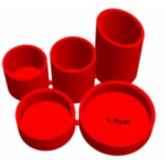

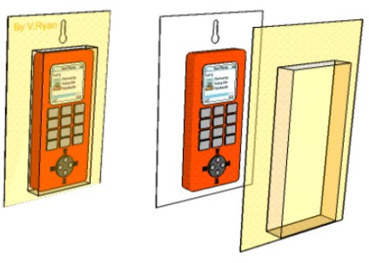
TO HELP YOU ANSWER THIS QUESTION
http://www.technologystudent.com/despro_ﬂsh/mats_ﬁnish1.html
17. Describe two ways in which metals are given a ‘ﬁnish’ to enhance and protect their surface. 2 x 2 marks
Finish 1:
WORLD ASSOCIATION OF TECHNOLOGY TEACHERS
https://www.facebook.com/groups/254963448192823/
www.technologystudent.com © 2018
V.Ryan © 2018
Finish 2:
18. Select one of the products shown below. Then, describe two reasons, for it being suitable for manufacture in large numbers / mass production. 2 x 2 marks
DESKTIDY
INJECTION MOULDING
‘PLASTIC’ TROPHY
ROTATIONAL MOULDING
BLISTER PACKAGING
VACUUM FORMING
TO HELP YOU ANSWER THIS QUESTION
http://www.technologystudent.com/joints/desk8.htm http://www.technologystudent.com/prddes1/rotate2.html http://www.technologystudent.com/gprep07/vac2.html
PRODUCT:
REASON 1:

Slide 9
REASON 2:
WORLD ASSOCIATION OF TECHNOLOGY TEACHERS https://www.facebook.com/groups/254963448192823/
www.technologystudent.com © 2018 V.Ryan © 2018
19. For the product you selected in question 18 - describe / explain the industrial process used in it’s manufacture. The industrial process is listed under the product name. 5 marks
TO HELP YOU ANSWER THIS QUESTION
http://www.technologystudent.com/joints/desk8.htm http://www.technologystudent.com/prddes1/rotate2.html http://www.technologystudent.com/gprep07/vac2.html
INDUSTRIAL PROCESS:
DESCRIPTION OF MANUFACTURING PROCESS INCLUDE NOTES AND A SKETCH(S)

Slide 10
20. Packaging has a range of important functions. Describe 2 functions, in detail, in the area below. 2 x 4 marks
WORLD ASSOCIATION OF TECHNOLOGY TEACHERS https://www.facebook.com/groups/254963448192823/
www.technologystudent.com © 2018
V.Ryan © 2018
TO HELP YOU ANSWER
Follow the links below.
www.technologystudent.com/despro2/packfn1.htm
THIS QUESTION
FUNCTION 1:
FUNCTION 2:

Slide 11
TO HELP YOU ANSWER THIS QUESTION
Follow the links below.
http://www.technologystudent.com/prddes1/custom1.html
21a. There is a diﬀerence between a CUSTOMER and a CLIENT. Write a description / explanation of a customer and a client. 2 x 4 marks
WORLD ASSOCIATION OF TECHNOLOGY TEACHERS
https://www.facebook.com/groups/254963448192823/
www.technologystudent.com © 2018
V.Ryan © 2018
CUSTOMER:
CLIENT:
21b. What is the diﬀerence between Service Industry and Manufacturing industry. In your answer give an example of a service industry and manufacturing industry? 4 marks

Slide 12
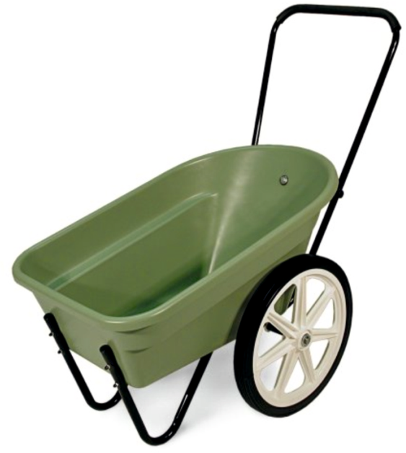

SECTION C - DESIGNING AND MAKING PRINCIPLES
WORLD ASSOCIATION OF TECHNOLOGY TEACHERS https://www.facebook.com/groups/254963448192823/
www.technologystudent.com © 2018
V.Ryan © 2018
GARDENING TROLLEY FOR THE ELDERLY
MAIN SPECIFICATION REQUIREMENTS
Requirement: The trolley should be easy to manouevre around the garden.
Requirement: The trolley should be lightweight, so that it is easy to move over soft ground, such as grass and soil.
_{Requirement:} Recycled and sustainable materials should be use to manufacture the trolley and it’s wheels.

Slide 13
22a. This question is about the product analysis of the garden trolley, seen on the previous page. The aim of product analysis is to help the designer develop even better designs and products in the future.
Study the gardening trolley carefully (consider it’s use by the elderly) and then complete the analysis by writing down your thoughts on the follow points: 4 x 2 marks 8 in total
TO HELP YOU ANSWER THIS QUESTION
Follow the link below.
http://www.technologystudent.com/joints_ﬂsh/garden1.html
MATERIALS:
WHEELS:
WEIGHT:
HANDLE:

Slide 14
TO HELP YOU ANSWER THIS QUESTION
Follow the link below.
http://www.technologystudent.com/prddes1/standard1.html
WORLD ASSOCIATION OF TECHNOLOGY TEACHERS https://www.facebook.com/groups/254963448192823/
www.technologystudent.com © 2018 V.Ryan © 2018
23a. What is a standard component. Give one or more examples in your answer.
4 marks
TO HELP YOU ANSWER THIS QUESTION
Follow the link below.
http://www.technologystudent.com/prddes1/standard9.html
23b. Write 4 advantages to a designer and manufacturer, of using standard components in a new product. 4 marks

Slide 15
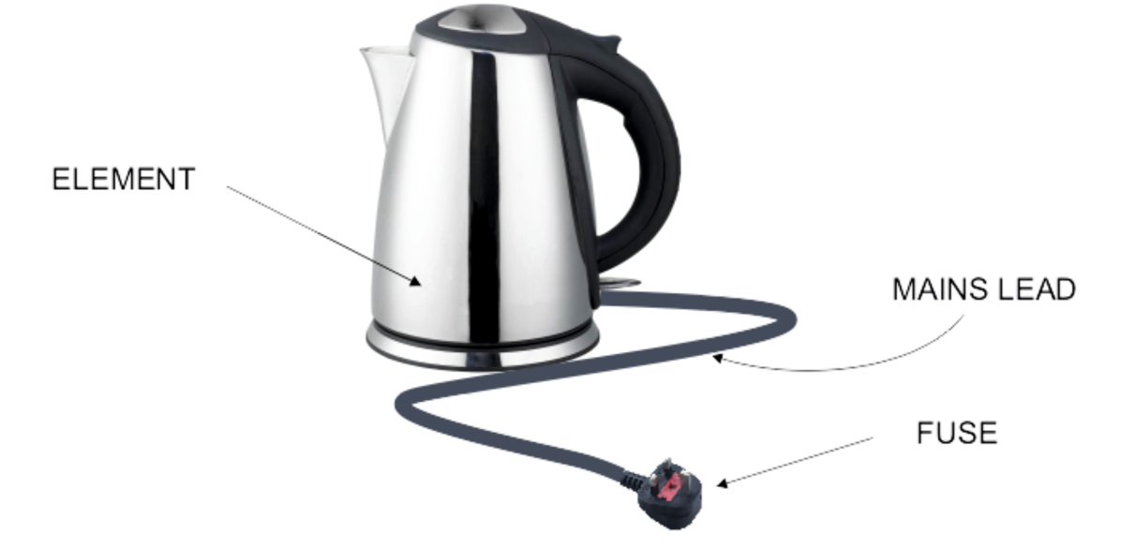
TO HELP YOU ANSWER THIS QUESTION
Follow the link below.
http://www.technologystudent.com/prddes1/repair1.html
WORLD ASSOCIATION OF TECHNOLOGY TEACHERS https://www.facebook.com/groups/254963448192823/ www.technologystudent.com © 2018 V.Ryan © 2018
24a. Customers often purchase products that can be repaired when faults develop, rather than throwing away a faulty product and buying a replacement ?
What are the advantages to the customer of buying a repairable product ? 5 marks
24b. Explain why it is important, to be able to repair each of the parts of the electric kettle, identiﬁed on the photograph. 3 marks

Slide 16
TO HELP YOU ANSWER THIS QUESTION
Follow the link below.
http://www.technologystudent.com/joints/prddes1.htm
WORLD ASSOCIATION OF TECHNOLOGY TEACHERS https://www.facebook.com/groups/254963448192823/
www.technologystudent.com © 2018 V.Ryan © 2018
25. Designers have to take account of factors, that aﬀect the development of a product, when they are designing. Describe / explain 4 factors. 4 x 2 marks (8 marks in total)
FACTOR 1:
FACTOR 2:
FACTOR 3:
FACTOR 4:

Slide 17
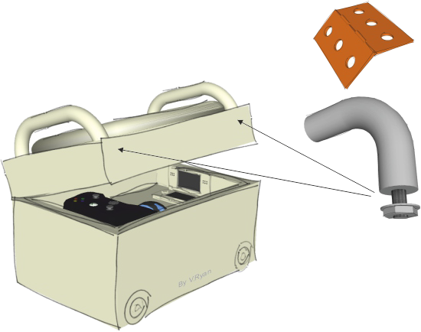
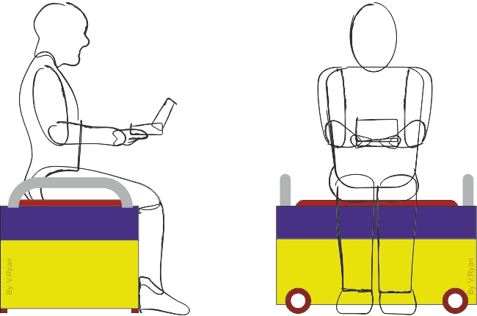
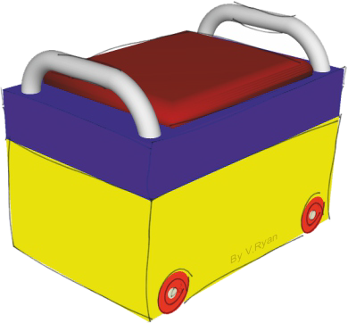
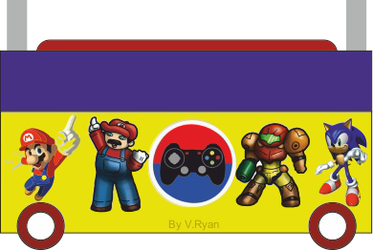
GAMES EQUIPMENT STORAGE UNIT
TO HELP YOU ANSWER THIS QUESTION
Follow the link below.
http://www.technologystudent.com/despro_ﬂsh/gamestore11.html
This page shows a storage unit for computer equipment. It is also a seat.
The lid opens to allow access to a number of trays that can be removed. The lid is lock-able.
The handles on the lid, are for lifting the lid and the entire unit, if required.
The small wheels are needed, when pushing the unit on the ﬂoor.
The question you are to answer is on the next page

Slide 18
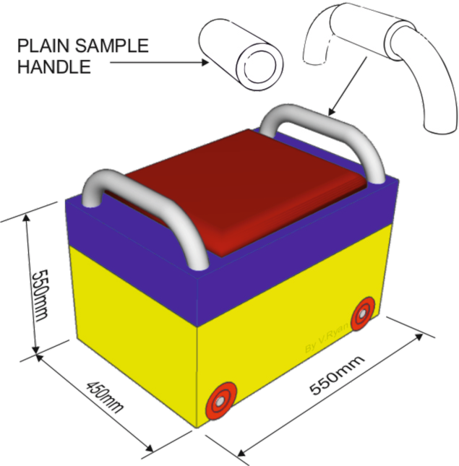
TO HELP YOU ANSWER THIS QUESTION
Follow the link below.
http://www.technologystudent.com/despro_ﬂsh/gamestore13.html
WORLD ASSOCIATION OF TECHNOLOGY TEACHERS https://www.facebook.com/groups/254963448192823/
26. In the space below, you are to design ONE of an identical pair of ergonomically shaped 'foam' handles, for the computer storage unit, that will slide onto the steel tube handles during manufacture. They will make lifting and moving the storage unit more comfortable.
A simple plain foam handle has been sketched opposite. The sketch shows the overall position and size of the 'ergonomic' handle, you are to design. 8 marks
www.technologystudent.com © 2018 V.Ryan © 2018

Slide 19
TO HELP YOU ANSWER THIS QUESTION
Follow the link below.
http://www.technologystudent.com/pdf14/maths4.pdf (page 11)
WORLD ASSOCIATION OF TECHNOLOGY TEACHERS https://www.facebook.com/groups/254963448192823/
www.technologystudent.com © 2018 V.Ryan © 2018
27. A student is trying to work the ergonomic dimensions (measurements) for the ‘round’ handle of a machine vice, that he intends to manufacture. The student measures the radius of the handle of an existing handle and ﬁnds it to be 25mm.
What is the circumference of the handle? 3 marks
What is the area of the ‘round’ end of the handle? 2 marks
FORMULA
FORMULA
AREA = πr ²
π (pi) = 3.14
CIRCUMFERENCE = 2 x π x r
π (pi) = 3.14
 | RADIUS
HANDLE 1 | 20
HANDLE 2 | 25
HANDLE 3 | 24
HANDLE 4 | 30
HANDLE 5 | 28
TOTAL
AVERAGE
The student collects the radius measurements of ﬁve machine vices and enters the data into a table of results, seen opposite.
Calculate the average radius and enter your result in the table 3 marks
Why could this measurement be useful when designing a new machine vice, based on the design above? 2 marks
WORLD ASSOCIATION OF TECHNOLOGY TEACHERS
https://www.facebook.com/groups/254963448192823/
www.technologystudent.com © 2017 V.Ryan © 2017

Slide 20
TO HELP YOU ANSWER THIS QUESTION
Follow the link below.
http://www.technologystudent.com/joints/photchrom1.html
WORLD ASSOCIATION OF TECHNOLOGY TEACHERS https://www.facebook.com/groups/254963448192823/
www.technologystudent.com © 2018 V.Ryan © 2018
28a. Designers need an understanding of smart materials. Photochromic inks have many practical applications. What are photochromic inks? 2 mark
28b. Describe two practical applications of photochromic inks. 2 x 3 marks
PRACTICAL APPLICATION 1:
PRACTICAL APPLICATION 1:

Slide 21
TO HELP YOU ANSWER THIS QUESTION
Follow the link below.
http://www.technologystudent.com/designpro/dev1.htm
WORLD ASSOCIATION OF TECHNOLOGY TEACHERS https://www.facebook.com/groups/254963448192823/
www.technologystudent.com © 2018 V.Ryan © 2018
29a. Designers invest time and eﬀort into developing an idea. What type of work / design processes do designers utilise when developing an idea ? 2 marks
TO HELP YOU ANSWER THIS QUESTION
Follow the link below.
www.technologystudent.com/despro_ﬂsh/gamestore11.html
29b. Look carefully at the drawings of the games equipment storage unit. Describe two ways in which you think it can be developed. Use sketches and notes. DO NOT DEVELOP THE HANDLE 2 x 3 marks

Slide 22
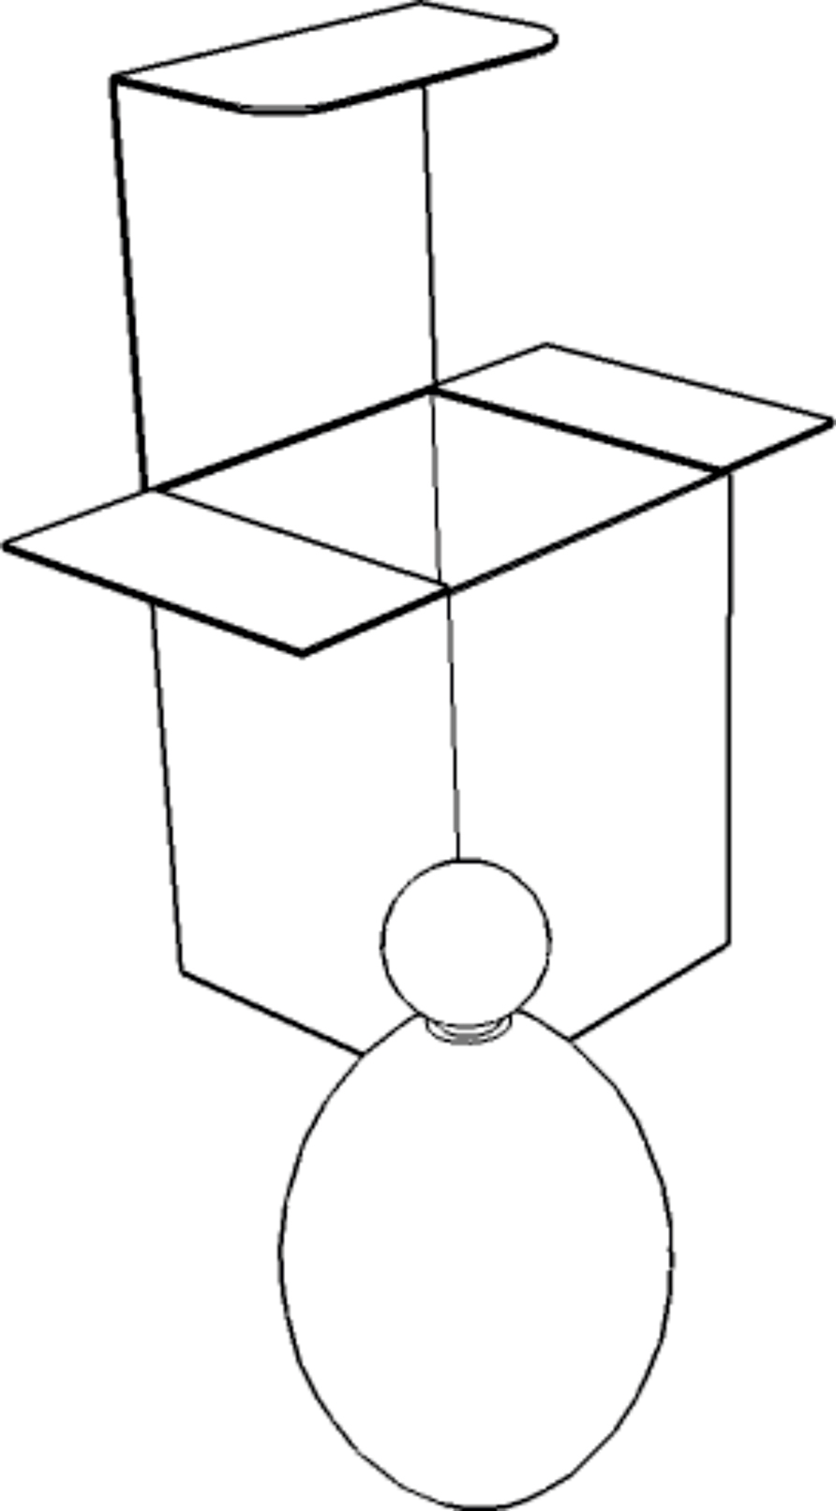
TO HELP YOU ANSWER THIS QUESTION
Follow the links below.
http://www.technologystudent.com/despro_ﬂsh/thick2.html
WORLD ASSOCIATION OF TECHNOLOGY TEACHERS
https://www.facebook.com/groups/254963448192823/
www.technologystudent.com © 2018 V.Ryan © 2018
30. Below is the packaging and bottle for perfume.
Using coloured pencils:
Select a suitable colour and add thick lines, to emphasise the outline of the bottle and its packaging. 3 marks
Add a series of thin coloured lines, to enhance the 3D eﬀect. 6 marks

