Slide 1
SAMPLE DESIGN AND TECHNOLOGY
GCSE EXAMINATION PAPER
(SAMPLE 3)
WORLD ASSOCIATION OF TECHNOLOGY TEACHERS https://www.facebook.com/groups/254963448192823/
www.technologystudent.com © 2018 V.Ryan © 2018
CENTRE NUMBER CANDIDATE NUMBER
SURNAME
FORENAME(S)
CANDIDATE SIGNATURE
2 HOURS ALLOWED
Materials required for this examination:
normal writing and drawing instruments
a calculator
a protractor.
Instructions to candidates:
Use black ink or black ball-point pen. Use pencil only for drawing.
Fill in the boxes at the top of this page.
Answer all questions.
You must answer the questions in the spaces provided. Do not write on
Do all rough work in this book. Cross through any work that you do not want to be marked.
blank pages.
Information
The marks for questions are displayed.
The maximum mark for this paper is 131.
There are 22 marks for Section A, 37 marks for Section B and 72 marks for Section C.
This example examination paper can be duplicated and printed out if required but not edited in any way.
The links to www.technologystudent.com cannot be removed.
The PDF ﬁle can be stored on school / college systems and distributed electronically (NO EDITING ALLOWED)
PLEASE RESPECT THE COPYRIGHT - report infringers to techteacher@technologystudent.com Not be distributed at courses or by course instructors / consultants
WORLD ASSOCIATION OF TECHNOLOGY TEACHERS https://www.facebook.com/groups/254963448192823/
www.technologystudent.com © 2018 V.Ryan © 2018

Slide 2

CORE TECHNICAL PRINCIPLES - SECTION A
The questions to follow are multiple choice. Tick one answer for each question.
WORLD ASSOCIATION OF TECHNOLOGY TEACHERS https://www.facebook.com/groups/254963448192823/
1. Which one of the following energy production systems is a fossil fuel ?
www.technologystudent.com © 2018 V.Ryan © 2018
Wind Power
Hydraulic Fracturing
Nuclear Power
Hydroelectricity
This link will help you answer this question
http://www.technologystudent.com/energy1/engex.htm
2. The characterbelow is standing still. What is this type of load?
This link will help you answer this question
http://www.technologystudent.com/forcmom/force1.htm
Dynamic
Resting
Static
Shear
3. A thermosetting plastic is:
Link to potential answer
http://www.technologystudent.com/designpro/plastic1.htm
Once 'set' these plastics cannot be reheated to soften, shape and mould.
These plastics can be reheated up to four times, but no more.
These plastics can be re-heated and therefore shaped in various ways.
This is a composite plastic, made up of several layers.

Slide 3
4. From the list of materials, identify the material that includes chromium in its composition.
WORLD ASSOCIATION OF TECHNOLOGY TEACHERS https://www.facebook.com/groups/254963448192823/
www.technologystudent.com © 2018 V.Ryan © 2018
Copper
Nylon
Stainless steel
Lead
Link to potential answer
http://www.technologystudent.com/designpro/metals1.htm
5. Which of the following names means, ‘materials on a very small scale’, on a scale of three atoms?
Small scale.
Micro-material
mini-substance
Nano
Link to potential answer
http://www.technologystudent.com/joints_ﬂsh/nanomats1.html
Which of the following statements describing ‘torsion’ is true?
Link to potential answer http://www.technologystudent.com/forcmom/force1.htm
  Torsion is a ‘twisting’ force.
  Torsion occurs when a material is stretched in a straight line.
  Torsion is the ‘impact’ when two materials are knocked together.
  Torsion is the term used to describe a rise in temperature of a material.
7. Which of the statements below is the deﬁnition of the physical property ‘Ductility’?
Link to potential answer
http://www.technologystudent.com/joints/conduct1.html
A ability of a material to resist impact when dropped .
The ability of a material to resist a stretching force.
The ability of a material to return to its original shape.
The ability of a material to change shape (deform) usually by stretching along its length.

Slide 4
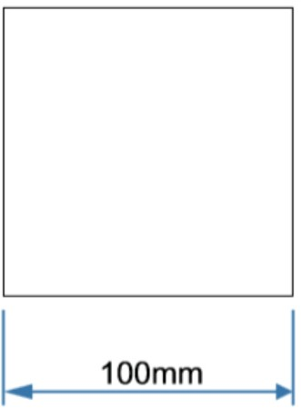
8. Which of the following statements is representative of crowd funding?
Link to potential answer http://www.technologystudent.com/prddes_2/crowd1.html
A group of designers fund the manufacture of a new product
The person / company seeking funding, sets up a 'page' on a website and asks for ﬁnancial support.
A number of companies directly sponsor a designer, in exchange for advertising.
The Government funds a designer through taxes.
WORLD ASSOCIATION OF TECHNOLOGY TEACHERS https://www.facebook.com/groups/254963448192823/
www.technologystudent.com © 2018
V.Ryan © 2018
Which of the following is the process called ‘etching’?
Link to potential answer http://www.technologystudent.com/joints_ﬂsh/etching1.html
  A process whereby paint is sprayed onto the surface of a material.
  A process that changes the colour of the surface of a metal.
  A process that creates a long-lasting protective coating on a metal.
  Acid is used to slowly remove the unprotected surface of a metal, for a decorative ﬁnish.
10. What is the area of the square shown below?
Follow the link to a potential answer.
http://www.technologystudent.com/pdf14/maths2.pdf
A. 1000mm²
B. 10000mm²
C. 1100mm²
D. 10100mm²

Slide 5
TO HELP YOU ANSWER THIS QUESTION
http://www.technologystudent.com/despro_ﬂsh/ﬂexply1.html
11. Give two reasons why Flexi-ply is suitable for making ‘curved’ products such as furniture. 2 marks
WORLD ASSOCIATION OF TECHNOLOGY TEACHERS https://www.facebook.com/groups/254963448192823/
Reason 1:
www.technologystudent.com © 2018 V.Ryan © 2018
Reason 2:
TO HELP YOU ANSWER THIS QUESTION
http://www.technologystudent.com/joints/pla1.html http://www.technologystudent.com/joints/poly2.html
12. Describe one practical application of polylactide (PLA). Include in your answer, how the environment will beneﬁt from the use of this material 2 marks
Practical Application:
Environmental Beneﬁt:
TO HELP YOU ANSWER http://www.technologystudent.com/energy1/frack1.html
THIS QUESTION
13. Hydraulic Fracking is a method of extracting oil and gas from rocks below the earth’s surface. Give two reasons why some people support this technique. 2 marks
Reason 1:
Reason 2:

Slide 6
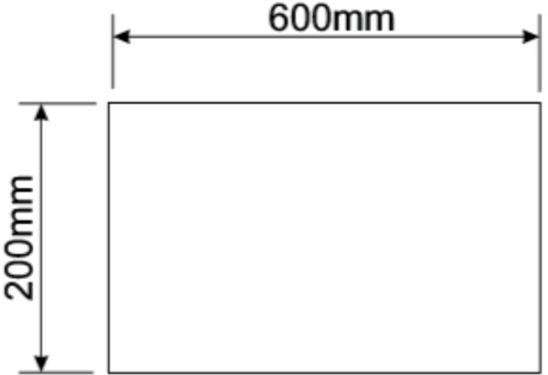
TO HELP YOU ANSWER http://www.technologystudent.com/energy1/frack1.html
THIS QUESTION
14. Give two reasons why some people are not in favour of hydraulic fracking. 2 marks
WORLD ASSOCIATION OF TECHNOLOGY TEACHERS https://www.facebook.com/groups/254963448192823/
Reason 1:
www.technologystudent.com © 2018 V.Ryan © 2018
Reason 2:
TO HELP YOU ANSWER THIS QUESTION
http://www.technologystudent.com/pdf14/ratios1.pdf
PAGE 9
15. This question is about using ratios to scale drawings?
What is the ratio of height to length of the rectangle?
You will gain marks for the calculation and your written explanation of the calculation.
4 marks
EXPLANATION:

Slide 7
SECTION B - Specialist Technical Principles
WORLD ASSOCIATION OF TECHNOLOGY TEACHERS https://www.facebook.com/groups/254963448192823/
www.technologystudent.com © 2018 V.Ryan © 2018
POLYURETHANE FOAM
16. Select one of the materials listed above.
BIOPOL
Name of Material
Describe your chosen materials manufacture. Include notes and a labelled sketch(s)
8 marks
TO HELP YOU ANSWER THIS QUESTION
http://www.technologystudentcom/joints/polyurethane1.html http://www.technologystudent.com/prddes1/biopola.html http://www.technologystudent.com/joints/poly2.html

Slide 8
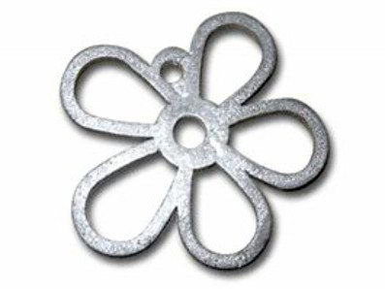
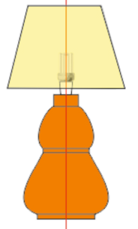
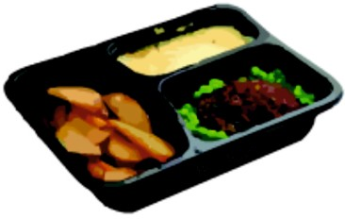
TO HELP YOU ANSWER THIS QUESTION
http://www.technologystudent.com/equip1/hﬁle1.htm http://www.technologystudent.com/equip1/buﬀ1.htm
17. Describe two processes that help to smooth / enhance the edge of a piece of 6mm thick acrylic. Use notes and a sketch. 2 x 2 marks
Process 1:
WORLD ASSOCIATION OF TECHNOLOGY TEACHERS https://www.facebook.com/groups/254963448192823/
Process 2:
www.technologystudent.com © 2018 V.Ryan © 2018
18. Select one of the products shown below. Then, describe two reasons, for it being suitable for manufacture in large numbers / mass production. 2 x 2 marks
DESKTIDY
PEWTER CASTING
WOOD - LAMP
WOOD TURNING
POLYETHYLENE TEREPHTHALATE VACUUM FORMED TRAY
TO HELP YOU ANSWER THIS QUESTION
http://www.technologystudent.com/equip_ﬂsh/pewtt1.html http://www.technologystudent.com/equip_ﬂsh/pewtt2.html http://www.technologystudent.com/equip1/woodturn1.html http://www.technologystudent.com/equip1/woodturning2.html http://www.technologystudent.com/equip1/wturning8.html http://www.technologystudent.com/joints/pet1.html http://www.technologystudent.com/joints/petevac1.html
PRODUCT:
REASON 1:

Slide 9
REASON 2:
WORLD ASSOCIATION OF TECHNOLOGY TEACHERS https://www.facebook.com/groups/254963448192823/
www.technologystudent.com © 2018 V.Ryan © 2018
19. For the product you selected in question 18 - describe / explain the industrial process used in it’s manufacture. The industrial process is listed under the product name. 5 marks
TO HELP YOU ANSWER THIS QUESTION
USE THE SAME LINKS AS QUESTION 18
INDUSTRIAL PROCESS:
DESCRIPTION OF MANUFACTURING PROCESS INCLUDE NOTES AND A SKETCH(S)

Slide 10
20a. What is the diﬀerence between batch production and continuous production? 4 marks
WORLD ASSOCIATION OF TECHNOLOGY TEACHERS https://www.facebook.com/groups/254963448192823/
www.technologystudent.com © 2018
V.Ryan © 2018
TO HELP YOU ANSWER
Follow the links below.
THIS QUESTION
http://www.technologystudent.com/joints/scalep1.htm
20b. Brieﬂy describe the stages involved in the batch manufacture of a product of your choice 4 marks
TO HELP YOU ANSWER
Follow the links below.
THIS QUESTION
http://www.technologystudent.com/joints/bat1.htm http://www.technologystudent.com/joints/batch1.htm

Slide 11
TO HELP YOU ANSWER THIS QUESTION
Follow the links below.
http://www.technologystudent.com/rmprp07/intman1.html
21a. What is Computer Integrated Manufacture (CIM)? 4 marks
WORLD ASSOCIATION OF TECHNOLOGY TEACHERS
https://www.facebook.com/groups/254963448192823/
www.technologystudent.com © 2018
V.Ryan © 2018
TO HELP YOU ANSWER THIS QUESTION
Follow the links below.
http://www.technologystudent.com/rmprp07/injec1.html
21b. Select a product that could be manufactured through Computer Aided Manufacture (CIM) and describe the stages involved in it’s manufacture 4 marks
PRODUCT: DESCRIPTION:

Slide 12
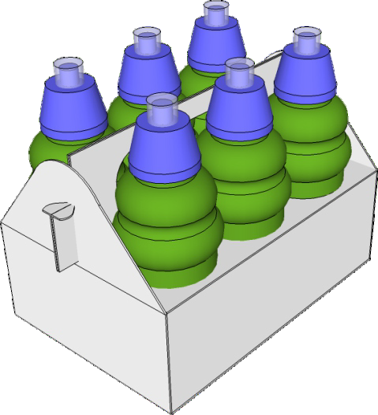
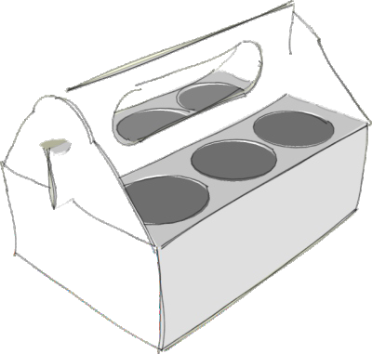
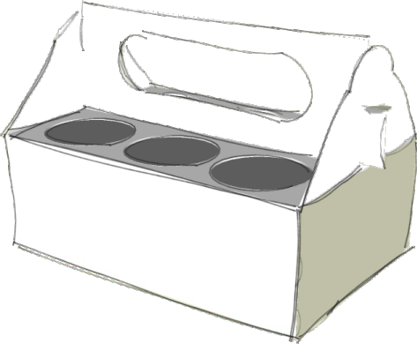
SECTION C - DESIGNING AND MAKING PRINCIPLES
WORLD ASSOCIATION OF TECHNOLOGY TEACHERS https://www.facebook.com/groups/254963448192823/
www.technologystudent.com © 2018 V.Ryan © 2018
DRINKS CONTAINER - PROMOTIONAL PACKAGING DESIGN FEATURES
The packaging seen below, has been designed to hold / store six ‘plastic’ bottles containing a natural fruit soft drink.
By V.Ryan

Slide 13
22. The packaging should have the following design features:
TO HELP YOU ANSWER Follow the link below.
THIS QUESTION http://www.technologystudent.com/prddes1/prodpack3.html
22a. Explain why the packaging should be sustainable. 2 marks
22b. Explain why it would be an advantage for the packaging to be educational.
2 marks
22c. Explain why the use of colour and images on promotional packaging, is an important design feature. 2 marks
22d. The packaging should allow ease of stacking on a supermarket shelf and during transport. 2 marks
22e. The packaging should promote a healthy diet.
2 marks

Slide 14
TO HELP YOU ANSWER THIS QUESTION
Follow the link below.
http://www.technologystudent.com/despro_3/promopk2.html
WORLD ASSOCIATION OF TECHNOLOGY TEACHERS https://www.facebook.com/groups/254963448192823/
23a. How is packaging used to promote products?
4 marks
www.technologystudent.com © 2018
V.Ryan © 2018
TO HELP YOU ANSWER THIS QUESTION
Follow the link below.
http://www.technologystudent.com/despro_3/promopk2.html
23b. How could a QR code (Quick Response Code) be used to promote a product?
4 marks

Slide 15
TO HELP YOU ANSWER THIS QUESTION
Follow the link below.
http://www.technologystudent.com/prddes1/repair1.html
WORLD ASSOCIATION OF TECHNOLOGY TEACHERS https://www.facebook.com/groups/254963448192823/ www.technologystudent.com © 2018 V.Ryan © 2018
24a. With the aid of a diagram, explain how packaging can be printed through the process of lithography? 5 marks
TO HELP YOU ANSWER THIS QUESTION
Follow the link below.
http://www.technologystudent.com/grp08/biodr1.html
24b. Give three reasons why the use of biodegradable ink, is beneﬁcial when printing on packaging . 3 marks
REASON 1:
REASON 2:
REASON 3:

Slide 16
TO HELP YOU ANSWER THIS QUESTION
Follow the link below.
http://www.technologystudent.com/prddes1/kite1.html
WORLD ASSOCIATION OF TECHNOLOGY TEACHERS https://www.facebook.com/groups/254963448192823/
www.technologystudent.com © 2018 V.Ryan © 2018
25a. These questions are related to British Standards and European Standards (8 marks in total)
What is the British Standards Institute? 2 marks
25b. What is the British Standards Institute Kite Mark? Include a sketch.
2 marks
25c. What is the Conformite European Symbol? Include a sketch of the symbol.
2 marks
25d. How do the two standards differ?
2 marks

Slide 17
TO HELP YOU ANSWER THIS QUESTION
Follow the link below.
http://www.technologystudent.com/prddes1/qual1.html http://www.technologystudent.com/prddes1/qual2.html http://www.technologystudent.com/prddes1/quality1.html
WORLD ASSOCIATION OF TECHNOLOGY TEACHERS
https://www.facebook.com/groups/254963448192823/
www.technologystudent.com © 2018 V.Ryan © 2018
Designers need an understanding of Quality Control and Quality Assurance
26a. What is meant by the term Quality Assurance?
4 marks
26b. What is meant by the term Quality Control?
4 marks

Slide 18

TO HELP YOU ANSWER THIS QUESTION
Follow the link below.
http://www.technologystudent.com/pdf14/maths5.pdf (page 8)
WORLD ASSOCIATION OF TECHNOLOGY TEACHERS https://www.facebook.com/groups/254963448192823/
VERTEX
www.technologystudent.com © 2018 V.Ryan © 2018
27. Below is a model a typical village church. The roof of the tower is a square pyramid.
A. What is the area of one side of the square pyramid?
h=300mm
X
Y
SQUARE PYRAMID
b=250mm
WORLD ASSOCIATION OF TECHNOLOGY TEACHERS https://www.facebook.com/groups/254963448192823/
www.technologystudent.com © 2017 V.Ryan © 2017
AREA = 1/2 X BASE X HEIGHT
6 marks
B. The labels X and Y represent the same part, one side of the square pyramid. Why does Y appear taller than X ? 2 marks
WORLD ASSOCIATION OF TECHNOLOGY TEACHERS
https://www.facebook.com/groups/254963448192823/
www.technologystudent.com © 2017 V.Ryan © 2017

Slide 19
TO HELP YOU ANSWER THIS QUESTION
Follow the link below.
http://www.technologystudent.com/joints/aroma1.html
WORLD ASSOCIATION OF TECHNOLOGY TEACHERS https://www.facebook.com/groups/254963448192823/
www.technologystudent.com © 2018 V.Ryan © 2018
28a. Designers need an understanding of smart materials. Aroma Pigments have many practical applications. What are aroma pigments? 2 marks
28b. Describe two practical applications of aroma pigments.
2 x 3 marks
PRACTICAL APPLICATION 1:
PRACTICAL APPLICATION 1:

Slide 20
TO HELP YOU ANSWER THIS QUESTION
Follow the link below.
http://www.technologystudent.com/despro_ﬂsh/evalintegr1.html
WORLD ASSOCIATION OF TECHNOLOGY TEACHERS https://www.facebook.com/groups/254963448192823/
www.technologystudent.com © 2018 V.Ryan © 2018
29a. Designers invest time and eﬀort, testing and evaluating a prototype. Why do designers test and evaluate? 2 marks
29a. Describe two features / aspects of a design, that designers evaluate. 2 x 3 marks
Feature/aspect 1:
Feature/aspect 2:

Slide 21
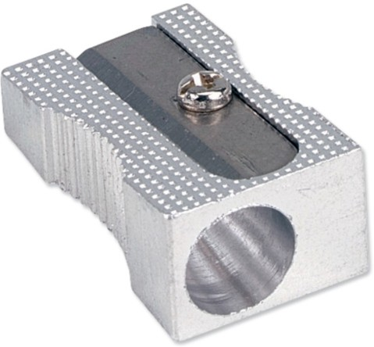
TO HELP YOU ANSWER THIS QUESTION
Follow the links below.
http://www.technologystudent.com/despro2/estper1.htm
WORLD ASSOCIATION OF TECHNOLOGY TEACHERS
https://www.facebook.com/groups/254963448192823/
www.technologystudent.com © 2018 V.Ryan © 2018
30. This is a simple pencil sharpener.
An two point perspective drawing of the sharpener has been started below.
Complete the outline of the sharpener.
3 marks
Add appropriate pencil shading, to enhance the ﬁnal ﬁnish. 3 marks

