Slide 1
STATIC AND DYNAMIC LOADS AND MECHANICAL ADVANTAGE
WORLD ASSOCIATION OF TECHNOLOGY TEACHERS https://www.facebook.com/groups/254963448192823/ www.technologystudent.com © 2023 V.Ryan © 2023
HELPFUL LINKS: https://technologystudent.com/forcmom/mechad1.html
1. Explain why the roof of the house shown below is an example of a ‘static’ load. 2 marks
B
y
V.
R
y
an
2.With reference to the drawing of a tightrope walker. Explain the meaning of the term dynamic load. 2 marks

Slide 2
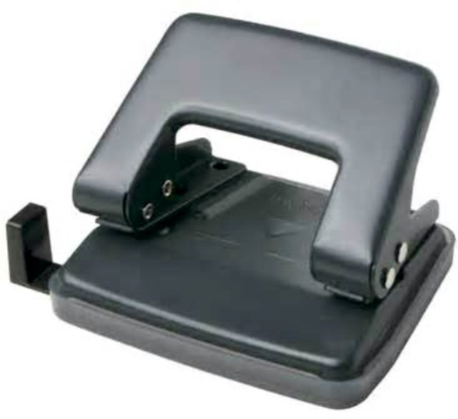
STATIC AND DYNAMIC LOADS AND MECHANICAL ADVANTAGE
WORLD ASSOCIATION OF TECHNOLOGY TEACHERS https://www.facebook.com/groups/254963448192823/ www.technologystudent.com © 2023 V.Ryan © 2023
HELPFUL LINKS: https://technologystudent.com/forcmom/mechad1.html
3. What is meant by the term ‘mechanical advantage’?
3 marks
Answer this question with reference to the hole punch opposite.

