Slide 1
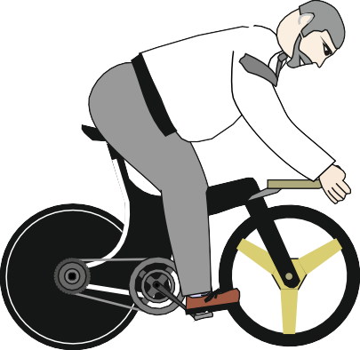
TYPES OF MOVEMENT / MOTION - QUESTIONS
WORLD ASSOCIATION OF TECHNOLOGY TEACHERS https://www.facebook.com/groups/254963448192823/ www.technologystudent.com © 2023 V.Ryan © 2023
HELPFUL LINKS:
https://technologystudent.com/forcmom/motion1.html https://technologystudent.com/forcmom/motion2.html
1. Motion involves movement of some kind. Four types of movement are listed below. Label the diagrams that represent motion, with the correct name. 4 marks
OSCILLATING LINEAR ROTARY RECIPROCATING
2. The items listed below all involve movement. Label each diagram with the correct type of movement. 4 marks
A. B. C. D.
9
12
3
6
BICYCLE WHEEL PISTON PENDULUM CLOCK LOCOMOTIVE
3. A cyclist travels along a road. Clear identify with labels, notes and arrows, all the types of motion, that you see in the diagram. 4 marks
LOTUS

