Slide 1
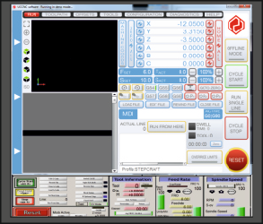
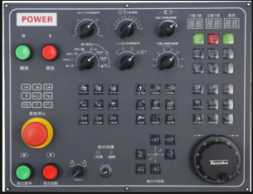
EXAMINATION QUESTIONS - CNC CENTRES
WORLD ASSOCIATION OF TECHNOLOGY TEACHERS https://www.facebook.com/groups/254963448192823/
www.technologystudent.com © 2020 V.Ryan © 2020
USEFUL LINK: https://technologystudent.com/cam/cnccentre1.html
1. What is a CNC Centre? 3 marks
2. Name the parts of the CNC Centre, identiﬁed by the arrows, 6 marks
3. What is meant by the term ‘CNC’? Include an explanation. 6 marks
C= N= C=

