Slide 1
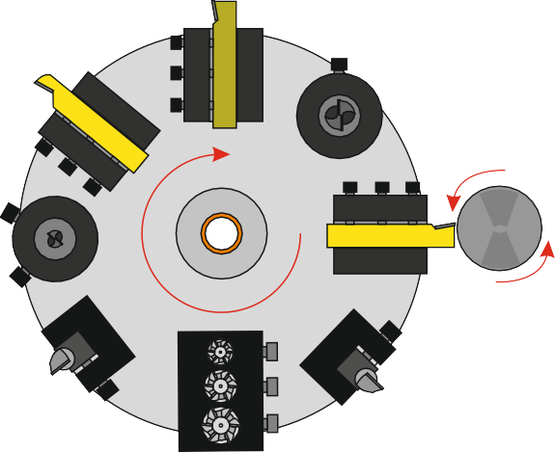
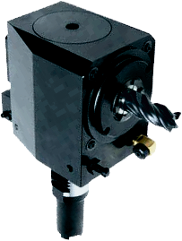
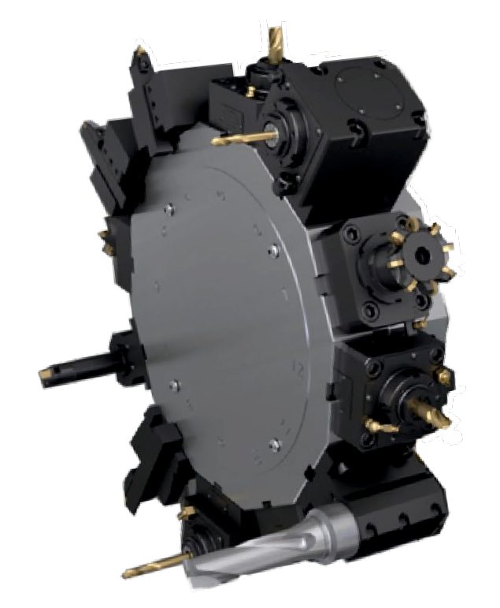
EXAMINATION QUESTIONS - CNC CENTRES
WORLD ASSOCIATION OF TECHNOLOGY TEACHERS https://www.facebook.com/groups/254963448192823/
www.technologystudent.com © 2020 V.Ryan © 2020
USEFUL LINK: https://technologystudent.com/cam/cnccentre3.html
1. Name and describe this tooling system, used with CNC Centres 4 marks
NAME:
2. What is an extended tool post, as used for Gang Tooling? Include a description and a sketch. 6 marks
3. What is meant by the engineering term ‘Live Tooling’? Make reference to the image opposite. 3 marks
LIVE TOOL
TURRET

