Slide 1
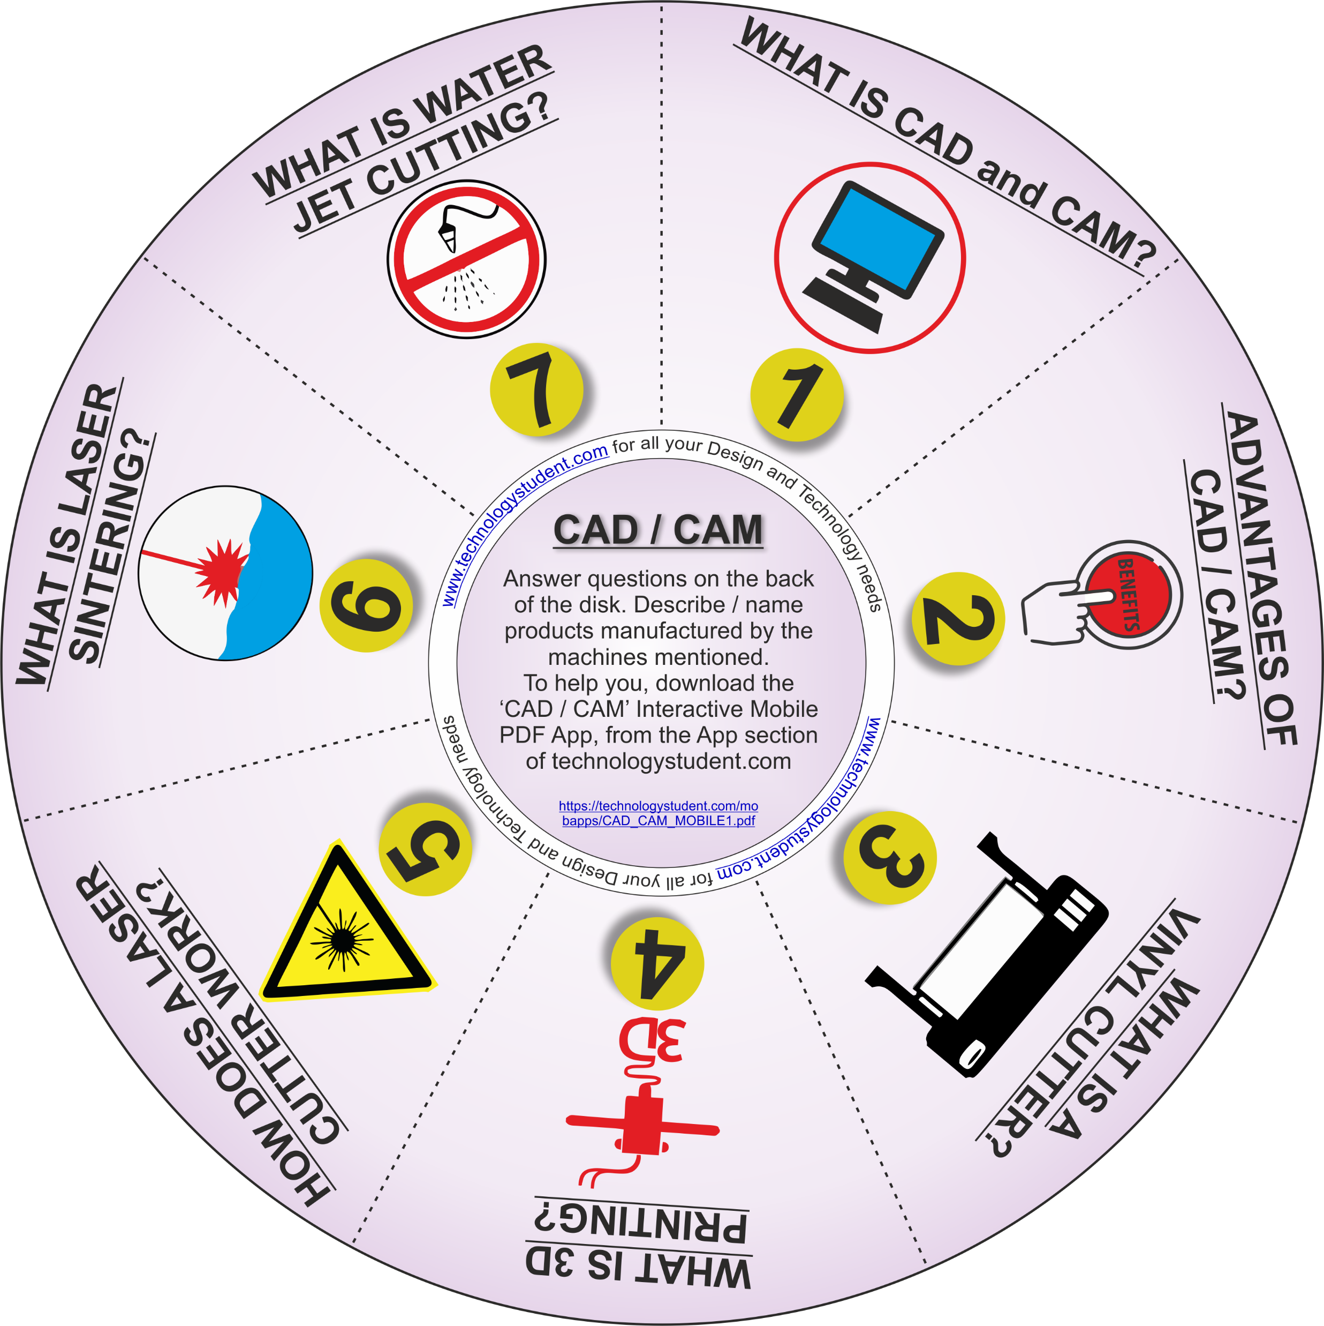
CAD / CAM
‘LEARNING CIRCLE’
The disk will help you revise CAD / CAM. Answer each question on the back of the disk. Where possible describe / name products manufactured by the machines mentioned.
For help, download the ‘CAD / CAM’ Interactive Mobile PDF App, from the App section of technologystudent.com
https://technologystudent.com/mobapps/CAD_CAM_MOBILE1.pdf
If you click on the circle, you will be able to rotate it, making it easier to read the symbols.

