Slide 1
LIQUID CRYSTALS DISPLAYS - EXAMINATION QUESTIONS
WORLD ASSOCIATION OF TECHNOLOGY TEACHERS https://www.facebook.com/groups/254963448192823/
www.technologystudent.com © 2021 V.Ryan © 2021
HELPFUL LINK: https://technologystudent.com/elec1/lcd1.htm
1. Draw a sketch / diagram, representing the following ‘states’ of matter: 6 marks
SOLID STATE
CRYSTALLINE STATE
LIQUID
2. Brieﬂy, what are liquid crystals? 3 marks
3. List four practical applications of liquid crystals. 4 marks
4. How does the liquid crystal display of a TV work? 4 marks

Slide 2
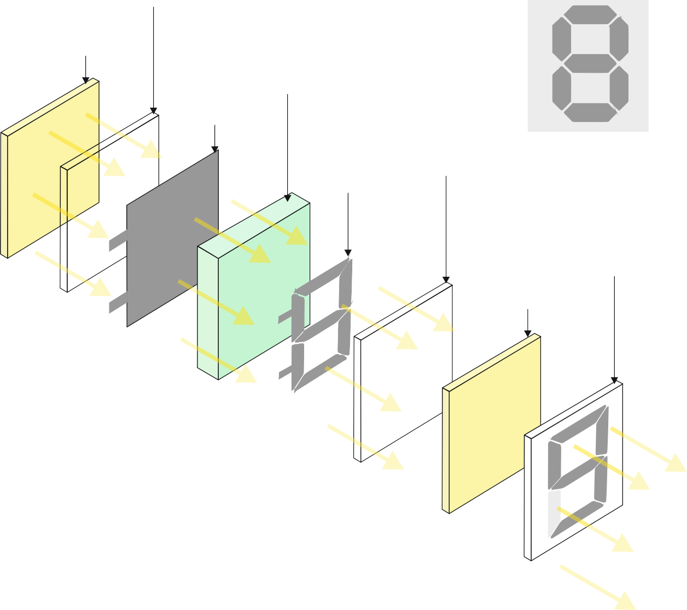
5. Describe the properties of LCDs, that make them a good choice. 4 marks
6. How does a simple seven segment display work? Use the diagram below to support your answer. 4 marks
MIRROR
GLASS FILTER
SEVEN SEGMENT LCD DISPLAY
1
6 2
POLARISING FILM
BACK LIGHT
LIQUID CRYSTAL LAYER
NEGATIVE ELECTRODE
7
5 3
V.Ryan © 2021
4
POSITIVE ELECTRODE
GLASS FILTER
GLASS COVER
POLARISING
FILM
V.Ryan © 2021
FINAL
IMAGE

