Slide 1
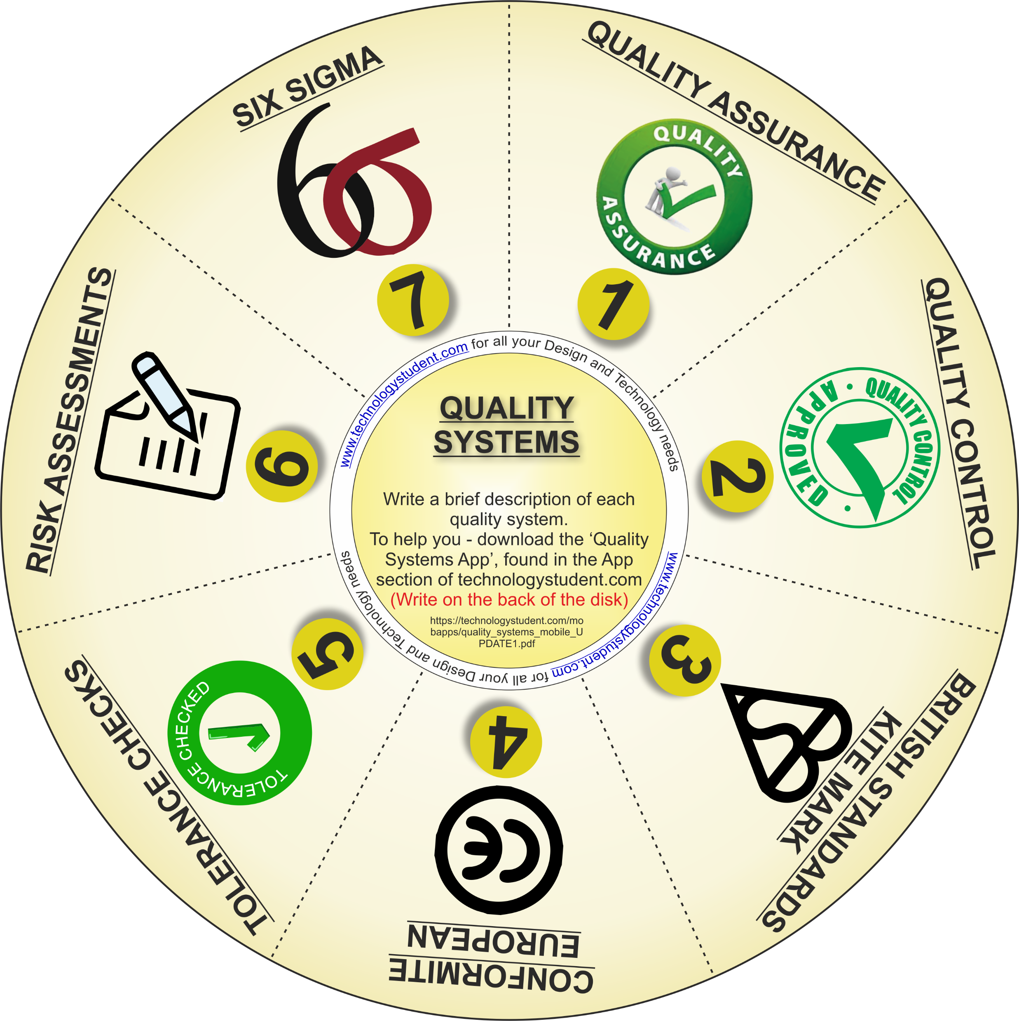
QUALITY SYSTEMS
‘LEARNING CIRCLE’
This disk will help you revise Quality Systems. For each one, write a brief description.
For help and information, download the ‘Quality Systems’ Interactive Mobile PDF App, from the App section of technologystudent.com
https://technologystudent.com/mobapps/quality_systems_mobile_UPDATE1.pdf
If you click on the circle, you will be able to rotate it, making it easier to read the symbols.

