Slide 1
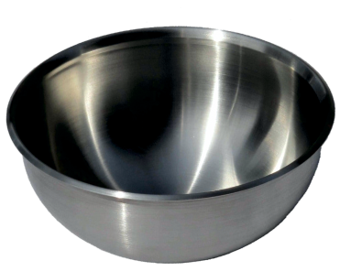
MAIN STAGES OF METAL SPINNING
WORLD ASSOCIATION OF TECHNOLOGY TEACHERS https://www.facebook.com/groups/254963448192823/
www.technologystudent.com © 2021 V.Ryan © 2021
HELPFUL LINK: https://technologystudent.com/equip_ﬂsh/spinning4.html
1. What are the three main stages of metal spinning? Include an image or a sketch of each stage. 6 marks
STAGE ONE: IMAGE / SKETCH DESCRIPTION:
STAGE TWO:
DESCRIPTION:
IMAGE / SKETCH
STAGE THREE:
IMAGE / SKETCH
DESCRIPTION:
2. What is the purpose / function of the bead edge shown below? 2 marks
BEAD EDGE

Slide 2
ADVANTAGES AND DISADVANTAGES OF METAL SPINNING
WORLD ASSOCIATION OF TECHNOLOGY TEACHERS https://www.facebook.com/groups/254963448192823/
www.technologystudent.com © 2021 V.Ryan © 2021
HELPFUL LINK: https://technologystudent.com/equip_ﬂsh/spinning4.html
3. List three advantages and three disadvantages of metal spinning. 6 marks
ADVANTAGES
DISADVANTAGES

