Slide 1
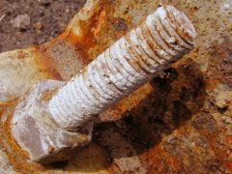
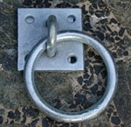
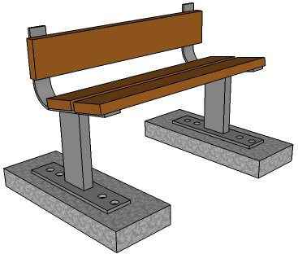
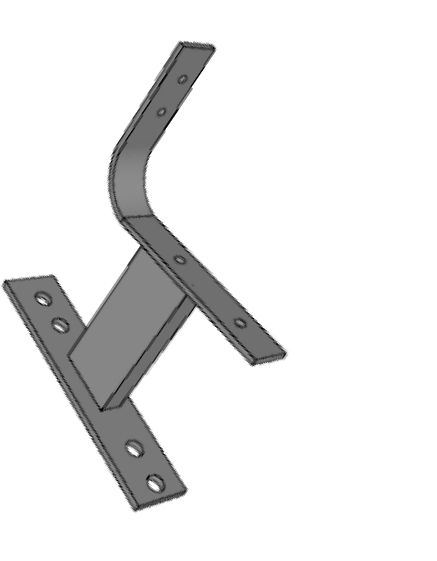
GALVANISING STEEL AND IRON
V.Ryan © 2009 World Association of Technology Teachers
HELPFUL LINK: https://technologystudent.com/equip_flsh/galv1.html
Two steel objects are shown opposite. They have suffered from rust damage. Name a process that could prevent rust appearing on the surface of steel.
PROCESS:
What conditions give rise to rust starting on the surface of a steel product?
3. The photograph shows a steel ring that has been galvanised to prevent rust. What does the term galvanised mean? How does it prevent rust?
4. The diagram below shows how the steel ends of an outside bench are galvanised. The aim is to prevent the steel from rusting.
Name the galvanising process that is taking place. Describe / explain the process.
TEAK
MOLTEN ZINC
HEATING ELEMENTS
STEEL
CONCRETE

Slide 2
PROCESS NAME:
DESCRIPTION / EXPLANATION:

