Slide 1
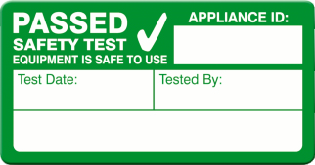
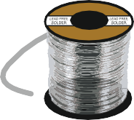
ELECTRONICS / SOLDERING AND BASIC SAFETY
WORLD ASSOCIATION OF TECHNOLOGY TEACHERS https://www.facebook.com/groups/254963448192823/ www.technologystudent.com © 2022 V.Ryan © 2022
WRONG / POTENTIAL HAZZARD
What is wrong / unsafe / bad practice, as identified by the diagrams / parts of diagrams, labelled below?
CORRECT / GOOD PRACTICE
Explain what is correct and good practice, as identified by the diagrams / parts of diagrams, labelled below?
K
L
1243z
Re-Test Due:
23/6/22 23/6/23
^{Test By:} Mr Pat. Longsdale
M
A
B
C _{D}
N R
ROLL OF SOLDER
O
F
Q
E
G
P
T
24v / LOW VOLTAGE SUPPLY
H I
V.Ryan © 2022
ELECTRONICS WORKSTATION
Pb
LEAD FREE SYMBOL
V.Ryan © 2022
S
240v
ROSIN FREE
ROSIN FREE SYMBOL
J

Slide 2
ELECTRONICS / SOLDERING AND BASIC SAFETY
WORLD ASSOCIATION OF TECHNOLOGY TEACHERS https://www.facebook.com/groups/254963448192823/ www.technologystudent.com © 2022 V.Ryan © 2022
WRONG / POTENTIAL HAZZARD
A.
B.
C.
D.
E.
F.
G.
H.
I.
J.
CORRECT / GOOD PRACTICE
K.
L.
M.
N.
0.
P.
Q.
R.
S.
T.

