Slide 1
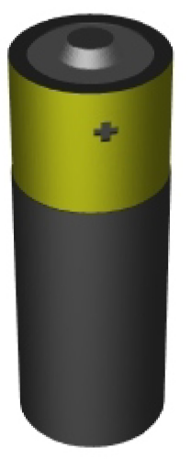
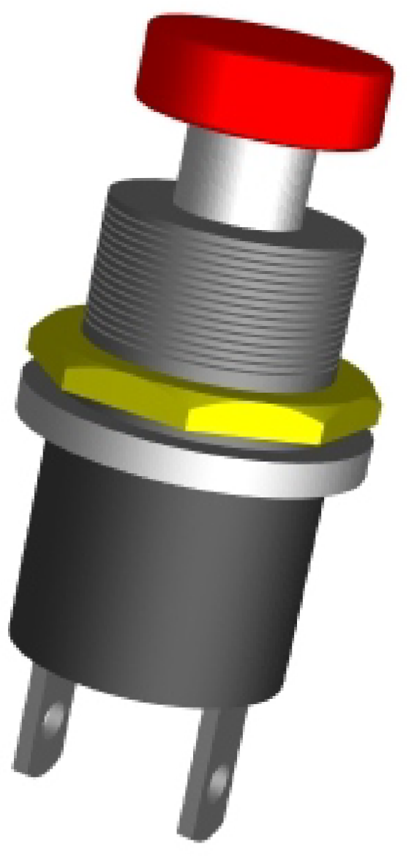
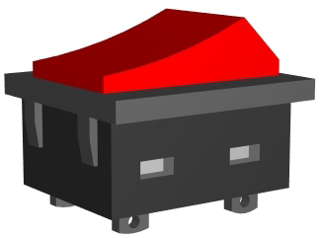
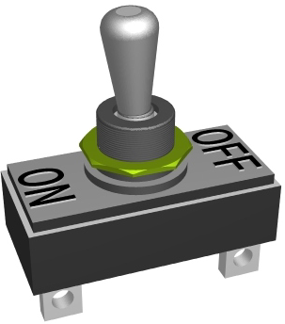
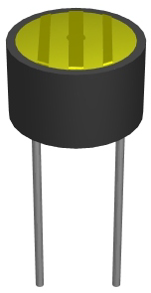
NAME:
IDENTIFYING ELECTRONIC COMPONENTS
V.Ryan © 2009 World Association of Technology Teachers
HELPFUL LINK: https://technologystudent.com/elec1/stelan1.htm
Below are a number of common electronic components you are likely to use when making circuits. Underneath each component write the correct name.
TRANSISTOR RESISTOR SLIDE SWITCH LIGHT DEPENDENT RESISTOR
PUSH SWITCH BATTERY SNAP
ROCKER SWITCH
LIGHT EMITTING DIODE (LED)
PRESET RESISTOR^{(LDR)} MOTOR INTEGRATED CIRCUIT (IC) BATTERY
MICRO-SWITCH
CONNECTOR TOGGLE SWITCH
+

Slide 2
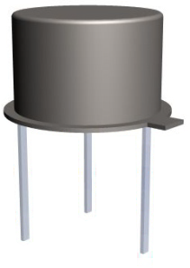
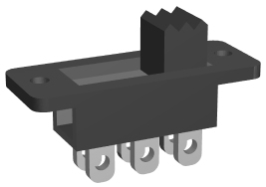
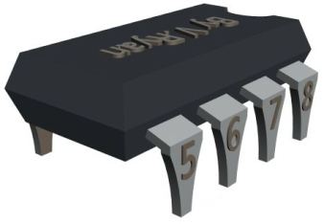
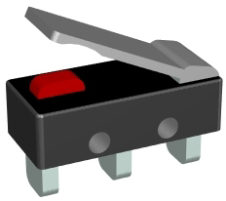
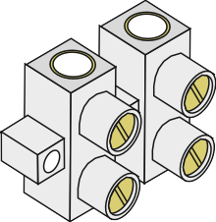
NAME:
IDENTIFYING ELECTRONIC COMPONENTS
V.Ryan © 2009 World Association of Technology Teachers

