Slide 1
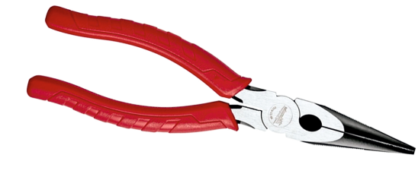
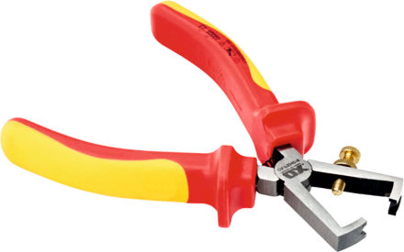
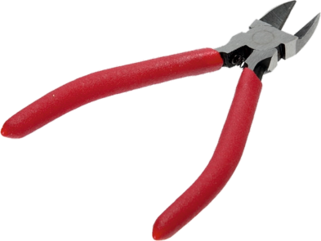
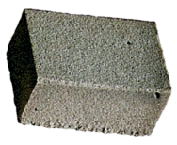
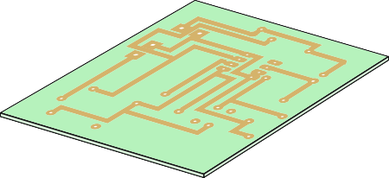
EQUIPMENT AND TOOLS FOR CIRCUIT WORK
WORLD ASSOCIATION OF TECHNOLOGY TEACHERS https://www.facebook.com/groups/254963448192823/
www.technologystudent.com © 2022 V.Ryan © 2022
HELPFUL LINK: https://technologystudent.com/elec1/stcomp1.htm
Some basic tools / equipment / components you may use when working with circuits are shown below. Name each tool / piece of equipment / component and explain what they are for.
1.
NAME:
EXPLANATION:
2.
NAME: EXPLANATION:
3.
NAME: EXPLANATION:
4.
COPPER TRACKS
NAME:
EXPLANATION:
5.
NAME: EXPLANATION:
6.
V.Ryan © 2022
NAME: EXPLANATION:
DAMP SPONGE

